Slide 1
A Case of Protein-Losing Enteropathy
MEDICAL GRANDROUNDS
Presented by: Genevieve L. Collado, MD
Moderator: Paolo P. Lorenzo, MD
Notes:
Good Morning Doctors, I’m Dr. Genevieve Collado, and together with Dr. Lorenzo, I will be presenting this morning’s medical grandrounds

Slide 2
Objectives:
To discuss the diagnostic approach to hypoalbuminemia with anasarca.
To present an unusual case of hypoalbuminemia secondary to Protein-Losing Enteropathy in Systemic Lupus Erythematosus.
Notes:
The objectives for today’s grandrounds are the following:

Slide 3
General Data
M.S.
62 y.o., Female
Married
Diagnosed with Invasive Ductal CA (2002)
Chief Complaint:
Increased Abdominal Girth
Notes:
Our patient is….

Slide 4
History of Present Illness
3 months prior
(January)
Self-medicated with Orlistat (Alli)
1 week later: facial swelling
bipedal edema
Consult:
Chest CT, Bone Scan, 2D echo: Normal
Diagnosis: Hypersensitivity Reaction
Orlistat discontinued
Facial swelling persisted
Notes:
History of present illness started 3 months prior to admission, when the patient self-medicated with Orlistat (Alli), an over-the-counter weight loss medication
A week later, she noted facial swelling and grade 1 bipedal edema
She subsequently consulted with her Cardiologist and Oncologist who worked-up the patient with a Chest CT, bone scan and 2d echo which all revealed normal results.
The impression given was a Hypersensitivity reaction secondary to Orlistat. The drug was discontinued however the patient still noted the persistence of the facial swelling.

Slide 5
History of Present Illness
2 months prior
(February)
Upper Respiratory Tract Infection
Worsening facial edema
Consult: Aldazide
Discontinued: generalized weakness
Notes:
2 months prior to admission, the patient developed an upper respiratory tract infection. At the same time, she noted worsening of the facial edema. She consulted once again with her Cardiologist who prescribed Aldazide (Spironolactone + Butizide)

Slide 6
History of Present Illness
2 months prior
(February)
Hospitalized (MMC) due to generalized weakness, increase in abdominal girth, appetite loss:
GASTROENTEROLOGY
To Consider Malabsorption
Abdominal UTZ: mild ascites, normal sized fatty liver
PFA: no localizing signs
Labs: hypoalbuminemia (2.3g/dl), hypercholesterolemia, +1 proteinuria, hematuria
Notes:
A few days after the URTI, she developed symptoms of:
Increase in abdominal girth, Body weakness, Easy fatigability, Shortness of breath on exertion, Appetite loss, early satiety
She was hospitalized in MMC for a week. GI service considered a Malabsorptive problem at this point. An abdominal UTZ showed mild ascites, normal sized fatty liver, no localizing signs on PFA. Blood chemistry showed:

Slide 7
History of Present Illness
Referrals:
NEPHROLOGY:
Nephrotic syndrome vs Lupus Nephritis
24 urine protein: normal
Abdominal CT scan of kidneys:
unremarkable
PULMONOLOGY:
To Consider Pulmonary Embolism
Chest Xray: pleural effusion
ProBNP, D-dimer: unremarkable
Arterial/Venous Duplex scan: normal
Notes:
She was given Domperidone, Esomeprazole, Spironolactone, Human Albumin, Furosemide, Rosuvastatin and Clexane

Slide 8
History of Present Illness
Decrease in ascites
Discharged after 7 days
Outpatient follow-up: ANA (+)
Notes:
A few days later, there was note of decrease in ascites. The patient opted to go home and was discharged after 7 days.
On outpatient follow-up, an ANA determination was requested revealing a positive result. Hence…

Slide 9
History of Present Illness
1 month prior
(March)
RHEUMATOLOGY consult
(+) ANA 1:320 dilution, Speckled pattern
Rx: steroids started but discontinued
Blurring of vision
Ophthalmology consult: Retinal edema
Notes:
1 month prior she was referred to a Rheumatologist due to a positive ANA with a significant dilution of 1 is to 320 with speckled pattern.
Steroids were started but discontinued
At the same time, she developed blurring of vision. Consult was sought with an Ophtalmologist who assessed the patient as having Retinal Edema

Slide 10
History Of Present Illness
1 day prior to Admission
On Follow up:
Repeat Albumin low: 2.5g/dl
Worsening of Ascites
Dyspnea
Grade 4 bipedal edema
Advised readmission

Slide 11
Review of Systems
(+) arthalgia
(+) easy bruisibility
No constipation
No diarrhea
No dysuria/frequency
No urgency/hematuria
No photosensitivity
No Raynaud’s phenomenon
No mouth sores
No skin rashes
No hair loss
No joint swelling
(+) gr. 4 bipedal edema
No fever
No weight loss
(+) appetite loss
No cough/cold
No headache
No dizziness
No nausea/vomiting
No chest pain
No palpitations
No orthopnea
No PND
No syncope

Slide 12
Past Medical History
Invasive Ductal CA, left breast (2002)
Post Lumpectomy (2002)
Post 6 cycles of chemotherapy & radiotherapy
Allergy: pineapple, seafood, dustmite, pollen
No Diabetes
No Hypertension
No Asthma
s/p Cesarean section 1974

Slide 13
Obstetric-Gynecologic History
G4P3 (4-0-1-3)
s/p spontaneous abortion 1970
s/p Cesarean section 1974
Menarche: 12 years old
28-30 day intervals
3-5 days duration
Pap smear (2005): normal
No history of OCP use
Last TVUS (2005): normal

Slide 14
Family History
(+) Diabetes
(+) Heart Disease
(+) Stroke
(+) Cancer: breast, gastric
No history of Autoimmune disease

Slide 15
Personal/Social History
Non-smoker
Occasional Alcoholic Beverage Drinker
No history of Illicit Drug Use
No recent travel history

Slide 16
Physical Examination
BP 130/90 CR 74bpm, regular
RR 20cpm Temp: 36.7C
Ht: 5’2” Wt: 66.4kg BMI: 27 kg/m2
Pain scale: 0/10
Appearance: conscious, coherent, not in cardiorespiratory distress, ambulatory, oriented to 3 spheres
Skin: moist skin, no rash over face or body
Head: (+) facial edema, (+) periorbital edema, (+) conjuctival edema, pink palpebral conjuctivae, anicteric sclera

Slide 17
Physical Examination
Ears/Throat: No nasoaural discharge, no cervical lymphadenopathy
Neck: supple neck, no palpable neck masses, thyroid not enlarged, no carotid bruit, neck veins not distended, JVP 9 cm H20
Chest: symmetrical chest expansion, decreased breath sounds over both lower lung fields, no retractions, no wheezes, no rhonchi
Heart: quiet precordium, apex beat 5th LICS, MCL, regular rate and rhythm, no murmurs, (-) S3, (-) S4, heart sounds not muffled

Slide 18
Physical Examination
Abdomen: globular, (+) ascites, abdominal girth 120cm, (+) shifting dullness, (+) flank edema, no caput medusae, no abdominal striae, normoactive bowel sounds, soft, nontender, no organomegaly
Extremities: (+) grade 4 bipedal edema, no cyanosis, full and equal pulses, no nail changes, no tender or swollen joints
Neurologic exam: essentially normal

Slide 19
Salient Features
Facial, conjunctival, periorbital edema
decreased breath
sounds, bilateral
Ascites, abdominal girth
120cm, shifting dullness,
flank edema
(+) grade 4 bipedal
edema
(+) ANA 1:320 dilution, Speckled pattern
Albumin low: 2.3- 2.5g/dl
62/F
Known Breast CA
(-) HPN, DM, Asthma
Recurrent facial swelling, bipedal edema
Exertional dyspnea, body weakness, easy fatigability, appetite loss

Slide 20
Intial Clinical Impression
Ascites probably secondary to Hypoalbuminemia
Hypoalbuminemia, etiology to be determined
Invasive Ductal Carcinoma
s/p lumpectomy (2002)
s/p 6 cycles of chemotherapy & radiotherapy

Slide 21
Problem #1: HYPOALBUMINEMIA
 | Adm | 4th | 8th | 10th | 13th | 31st | 40th | 42nd
Albumin | 2.0 | 2.3 | 1.6 | 2.10 | 1.9 | 2.3 | 2.7 | 3.2
Ascites, anasarca: To consider Malabsorption
Albumin 2.0 g/dl (normal 3.5-5.2 g/dL)
Previous admission- Albumin: 2.3g/dl
Refractory to Human albumin
Repeat Albumin (outpatient): 2.5g/dl
EGD and colonoscopy: boggy, edematous stomach with easily detachable villi
Diagnosis: Duodenitis, Diffuse colitis
Notes:
The main problem of our patient was persistence of hypoalbuminemia. This table shows the albumin determination throughout the course of her confinement. It was consistently at low levels.
Thus with hypoalbuminemia and ascites, anasarca: the consideration was a Malabsorption syndrome. EGD and colonoscopy was done showing…
The findings were nonspecific inflammation

Slide 22
ESOPHAGOGASTRODUODENOSCOPY

Slide 23
Colonoscopy

Slide 24
Histopathology of GI specimen
Esophageal mucosa: unremarkable eptihelium
Gastric mucosa: chronic gastritis
Duodenal mucosa: chronic duodenitis
Ascending colon mucosa: chronic colitis
Descending colon mucosa: chronic colitis
Ileal mucosa: chronic ileitis

Slide 25
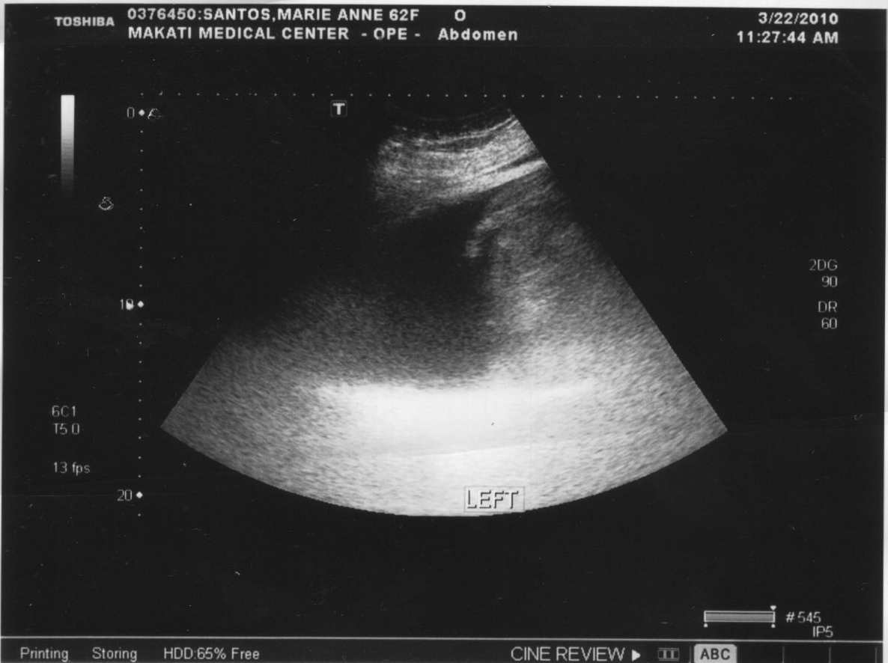
Problem #1: HYPOALBUMINEMIA
Ultrasound guided pigtail drainage: Ascitic fluid
Drained 1L of transudative fluid
Ascitic fluid sent for Immunohistochemistry studies

Slide 26
Problem #1: HYPOALBUMINEMIA
NEPHROLOGY follow-up:
Nephrotic Syndrome vs Lupus Nephritis
Hyponatremia secondary to Water Excess and decreased Intravascular volume (3rd spacing of fluids)
- unremarkable 24hour urine protein (288mg/24hr)
- Abdominal CT scan: moderate bilateral pleural effusion with ascites, anasarca, renal cortical cyst
4th hospital day: worsening of anasarca
2.4kg weight gain
Notes:
She was referred back to Nephrology service who considered Nephrotic sydrome vs the possibility of Lupus Nephritis
Electrolytes showed hyponatremia which was attributed to Water excess and decreased intravascular volume due to 3rd spacing of fluids
A 24 hour urine protein was unremarkable and abdominal CT scan showed ascites. (RADIO TO PRESENT)
She was given Cefuroxime, Metronidazole, Spironolactone, Furosemide, Rabeprazole, Human Albumin, Heparin
Total parenteral nutrition

Slide 27
PULMONOLOGY referral: shortness of breath, decreased breath sounds
Chest Xray: bilateral pleural effusion
Chest Ultrasound: 840ml
Ultrasound-guided pleural pigtail drainage: Transudate
Notes:
Due to shortness of breath and decreased breath sounds, she was referred back to Pulmonology service. Chest xray showed bilateral pleural effusion and Chest Ultrasound showed collection of fluid amounting to 840ml.
Thus ultrasound guided pigtail drain of the chest was done, revealing a transudate.

Slide 28
Problem #1: HYPOALBUMINEMIA
CARDIOLOGY referral
normal 2d echo
Hydrocortisone started
Elevated ESR
ALLERGOLOGY/IMMUNOLOGY referral
To consider C1 Esterase Inhibitor Deficiency
(angioedema, GI edema)
Danazol
Work-up for possible causes of albumin loss done:
Protein-Losing Enteropathy entertained
Notes:
On the 4th hospital day, the patient was referred to Cardiology service for episodes of tachycardia. Constrictive pericarditis was considered however 2decho was normal.
At this point, an elevated ESR pointed to a possible connective tissue disease process, hydrocortisone was started.
On the 8th hospital day, allergology/immunology referral
Danazol: synthetic steroid derived from ethisterone
Indications: indicated for the prevention of attacks of angioedema of all types (cutaneous, abdominal, laryngeal) in males and females.

Slide 29
Problem #1: HYPOALBUMINEMIA
14th hospital day: RHEUMATOLOGY
To consider Autoimmune disease
ANA (+) 1:320 dilution speckled pattern
IV IG infusion
No complications noted
Follow-up Chest xray: clearing of pleural effusion

Slide 30
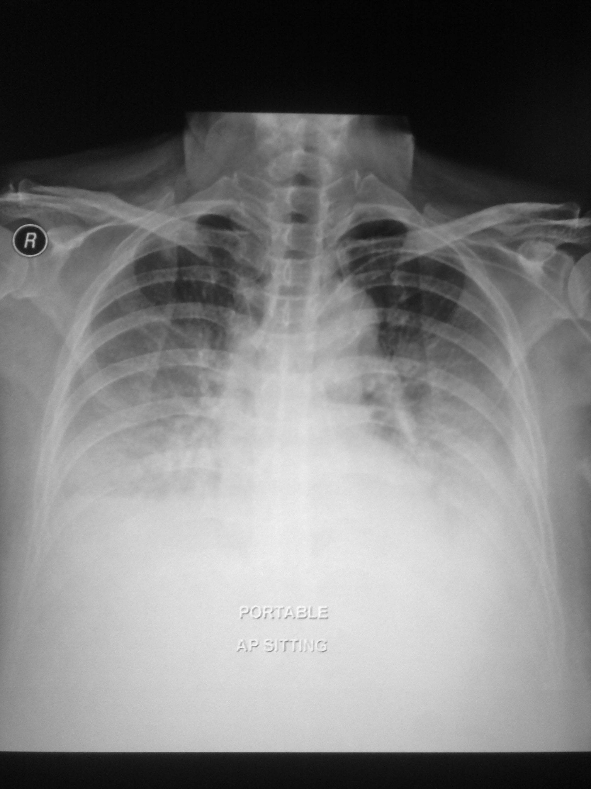
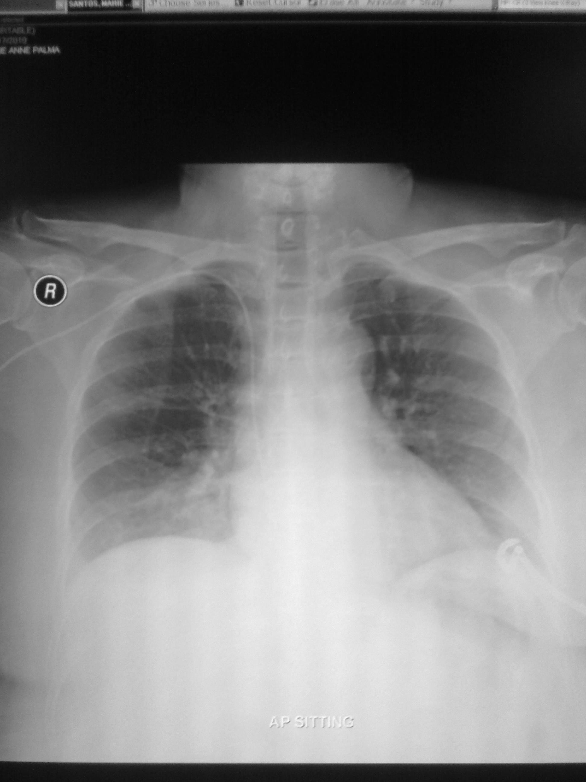
Mar. 9, 2010
Apr. 17, 2010

Slide 31
Problem #1: HYPOALBUMINEMIA
20th hospital day:
Protein-Losing Enteropathy as an initial manifestation of SLE considered
(+) ANA 1:320 speckled pattern
Hypoalbuminemia, Anasarca
All possible etiologies ruled out
50 established case reports
Started on Cyclophosphamide + Azathioprine
30th hospital day: marked decrease in anasarca

Slide 32
Problem #2: Recurrent/New Malignancy
For completion of work-up:
Referral: OB-GYNECOLOGY
Transvaginal Ultrasound: normal
Referral: ONCOLOGY
Elevated CA-125 levels: 763 (normal<30)
Other tumor markers: negative
PET scan recommended: unremarkable
Notes:
Our 2nd problem was a recurrent or possible new malignant process
For completion of workup, she was referred to OB-Gyne with the consideration of Meig’s sydnrome however TVUS was normal
Likewise, a referral to Oncology was made due to elevated CA-125. A PET scan was recommended to exclude disease recurrence or appearance of a new primary malignancy, such as Ovarian Cancer, which revealed unremarkable findings.

Slide 33
Course in the Wards
42nd hospital day:
2 weeks after 1st dose Cyclophosphamide
Marked decrease in anasarca and ascites
Discharged improved and stable
Outpatient basis:
Subsequent doses of Cyclophosphamide

Slide 34
ASCITES
Serum-Ascites Albumin Gradient (SAAG)
SAAG = (serum albumin) – (albumin in ascitic fluid)
High Gradient (> 1.1 g/dL): portal hypertension
- Increased hydrostatic pressure within blood vessels
- Causes:
High protein >2.5g/dL: Cardiac failure
Low protein < 2.5 g/dL: Liver cirrhosis, Budd Chiari syndrome
Notes:
SAAG: helps determine cause of ascites
High gradient (>1.1): due to portal hypertension
Due to increased hydrostatic pressure within the blood vessels of the hepatic portal system, which in turn forces water out into the peritoneal cavity but leaves proteins such as albumin within the vasculature
Important causes of high SAAG ascites (> 1.1 g/dL) include:high protein (>2.5): heart failure
low protein (<2.5): cirrhosis of the liver, Budd Chiari syndrome

Slide 35
ASCITES
Low Gradient (< 1.1 g/dL): not associated with increased portal hypertension
- Causes: Nephrotic syndrome, Cancer, Malnutrition, GI loss of protein
The patient:
Serum albumin – Ascitic fluid albumin
1.9 g/dl - 0.9g/dl = 1.0 g/dl → LOW GRADIENT
Notes:
Low gradient (< 1.1 g/dL) indicates ascites not associated with increased portal pressure, including nephrotic syndrome, tuberculosis, and various types of cancer.

Slide 36
HYPOALBUMINEMIA
Hypoalbuminemia (SAAG <1.1 g/dL)
Nephrotic syndrome
Protein-losing enteropathy
Severe malnutrition with anasarca
Mechanism:
Decreased Protein Synthesis
Deficient Protein Intake (Malnutrition)
Excessive protein loss
Clinical Manifestations of:
ASCITES
PLEURAL EFFUSION
ANASARCA

Slide 37
Differential Diagnoses:
Renal cause: Nephrotic syndrome
GI cause: Protein-Losing Enteropathy
Severe Malnutrition
Rule out: Cardiac cause
Low gradient SAAG
Normal cardiac work-up

Slide 38
Approach to Hypoalbuminemia and Anasarca
Notes:
When presented with hypoalbuminemia and anasarca, we can focus on 4 possible areas of pathology

Slide 39
Approach to Hypoalbuminemia

Slide 40
Approach to Hypoalbuminemia

Slide 41
Approach to Hypoalbuminemia

Slide 42
Approach to Hypoalbuminemia

Slide 43
Approach to Hypoalbuminemia

Slide 44
Approach to Hypoalbuminemia

Slide 45
GI LOSS: Hypoalbuminemia
Excessive loss of serum protein in GI tract:
⬇
PROTEIN-LOSING ENTEROPATHY

Slide 46
Protein-Losing Enteropathy
Hypoalbuminemia and generalized edema
3 mechanisms:
1. Mucosal disease with ulceration
A) Chronic gastric ulcer
B) Gastric carcinoma
C) Lymphoma
D) Inflammatory Bowel Disease
D) Idiopathic Ulcerative Jejunoileitis
Notes:
1. Mucosal disease with ulceration with protein loss across disrupted mucosal surface

Slide 47
Protein-Losing Enteropathy
2. Lymphatic Obstruction
A) Primary intestinal lymphangiectasia
B) Secondary obstruction due to heart disease, infection, neoplasm, retroperitoneal fibrosis, or sarcoidosis
3. Alterations in mucous capillary permeability
A) Menetrier’s Disease
B) Zollinger-Ellison syndrome
C) Acute viral or eosinophilic gastroenteritis
D) Celiac Sprue
E) Allergic protein losing enteropathy
F) Giardiasis or hookworm infection
G) Amyloidosis
H) Immunodefiency
I) SLE
Notes:
2. Lymphatic Obstruction causing loss of protein rich chyle

Slide 48
Our patient: EGD/Colonoscopy
Chronic Duodenitis, Colitis, Ileitis
Biopsy: Chronic inflammation
Rules out Mucosal ulcerated lesions and Lymphatic obstruction causes of Protein-Losing Enteropathy
⬇
Alterations in Mucosal Capillary Permeability

Slide 49
Back to our patient…
(+) ANA 1:320 dilution, speckled pattern
Serositis (ascites, pleural effusion)
Negative: anti-dsDNA, anti-Sm, anti-SSA, anti-SSB, anti-RNP
2 of 11 American College of Rheumatology (ACR) criteria fulfilled, however…
IS THIS STILL SYSTEMIC LUPUS ERYTHEMATOSUS?

Slide 50
American College of Rheumatology (ACR) criteria of SLE (4 of 11)
Malar rash
Discoid rash
Photosensitivity
Oral ulcers
Arthritis
Serositis
Renal disorder
Neurologic disorder
Hematologic disorder(anemia, thrombocytopenia)
Immunologic disorder (Anti-dsDNA, anti-Sm)
Antinuclear Antibodies (ANA positive)
Notes:
ACR classification criteria was established (1982, revised in 1997) mainly for the use in SCIENTIFIC RESEARCH.
Not intended to be used to diagnose individuals
Created for the purpose of identifying patients for CLINICAL STUDIES

Slide 51
Is the PLE related to SLE?
PLE unusual manifestation of SLE
Generalized edema in patients without severe proteinuria
May be the first manifestation of the disease
Most common cause of hypoalbuminemia in SLE: nephrotic syndrome (Lupus Nephritis)
Diagnosis of exclusion
Total of 50 CASES of PLE in SLE
Notes:
Protein-losing enteropathy: rare manifestation of SLE, and even more rare as an initial presentation.
Nearly 50 cases are reported in present literature and our patient may be the first reported in the Philippines

Slide 52
“SLE related Protein Losing Enteropathy”
Retrospective analysis of 15 patients diagnosed with PLE (ages 19-71 years old)
(+) ANA in all patients, anti-dsDNA negative in most
All had marked hypoalbuminemia, normal urine protein
8 of 15 had enteropathy as initial presentation of SLE, with 11/15 having ascites as a manifestation of PLE
All patients ultimately met ACR criteria for the diagnosis of SLE, though one took as long as 30 years
Majority were steroid responsive, with the remainder responding to added immunosuppressants
Overall good prognosis
Conclusion: PLE can be the initial presentation of SLE or develop a very long time after the diagnosis of SLE
Protein-Losing Enteropathy in SLE: analysis of clinical features of 15 patients: Zheng et al J Clin Rheumatol 2007;13: 313–316

Slide 53
Case Report: “A case of systemic lupus erythematosus presenting with protein-losing enteropathy”
24/F: Anasarca, ascites, mild bilateral pleural effusion, eyelid edema, lower extremity edema
Work-up: thrombocytopenia, hypoalbuminemia, hypercholesterolemia, hypocomplementemia, elevated ESR, normal 24 hour urine protein collection
ANA (speckled pattern) and elevated CA-125 antigen
Radiologic studies: mild pleural effusion, moderate transudative ascites
Diagnosed with 99m Tc-labelled Human Ig scintigram
Endoscopy: gastric, duodenal jejunal biopsies showed chronic inflammation
Renal biopsy: no findings of nephritis
Improved with 3 doses of Cyclophosphamide and low-dose steroids
“A case of systemic lupus erythematosus presenting with protein-losing enteropathy”, Turkcapar et al, Turkish Journal of Gastroenterology, 2006
Notes:
Case report: “A case of systemic lupus erythematosus presenting with protein-losing enteropathy”, Turkcapar et al, Turkish Journal of Gastroenterology, 2006

Slide 54
“Protein-Losing Enteropathy with SLE: Response to Cyclophosphamide”
37/F: hypoalbuminemia, generalized edema
Diagnosed with SLE 12 years prior (polyarthritis, malar rash, xerophthalmia, Raynaud’s phenomenon, hair loss)
Positive ANA with 1:640 speckled pattern
Anti-dsDNA, anti-SSb-La, Anti-Sm negative
Liver enzymes, renal function, 24hr proteinuria all normal
Refractory to prednisone and azathioprine
Reached remission with cyclophosphamide
Protein-Losing Enteropathy Associated with Systemic Lupus Erythematosus: Response to Cyclophosphamide. Werner de Castro, Appenzeller, Bertolo. Rheumatology Int (2005) 25: 135-138

Slide 55
“Protein-Losing Enteropathy Exacerbated with the Appearance of Symptoms of SLE”
38/F: facial edema, conjunctival edema
Hypoproteinemia and hypoalbuminemia (1.3 g/dl)
ANA (+) speckled pattern
C3, C4 all within normal limits
Urine, liver, heart tests: normal
Tm-labeled albumin scintigraphy (+)
Reached remission: prednisolone
Protein-Losing Enteropathy Exacerbated with the Appearance of Symptoms of SLE” Yoshima, et. Al, Internal Medicine, May 2002

Slide 56
 | Zheng, et al.2007 | Turkcapar et al. 2006 | Castro, et al 2005 | Yoshima, et. al 2002 | PATIENT
ANA | (+) speckled | (+) speckled | (+) 1:640 speckled | (+) speckled | (+) 1:320 speckled
Anti- dsDNA, Anti-Sm | Negative | Negative | Negative | Negative | Negative
Albumin | Low | Low | Low | Low | Low
PLE | (+) (initial) | (+) confirmed | (+) | (+)confirmed | (+) (initital)
SLE | (+) | (+) | (+) | (+) | (+)
Edema | (+) | (+) | (+) | (+) | (+)
Cyclophosphamide or Steroids | Steroids | Cyclophos-phamide | Cyclophosphamide | Steroids | Cyclophos phamide

Slide 57
Similar features of Case reports
PLE is a subgroup of SLE
Characteristics:
1. Protein-losing enteropathy
2. ANA positivity showing speckled pattern
3. Anti-dsDNA negative
4. edema and hypoalbuminemia without renal protein loss

Slide 58
How to Diagnose PLE
Rule out other causes (renal function tests, 24 hour urine protein, gastroscopy with biopsy, liver function tests, 2D echocardiogram)
Radioisotopic studies
24hour stool clearance of alpha-antitrypsin

Slide 59
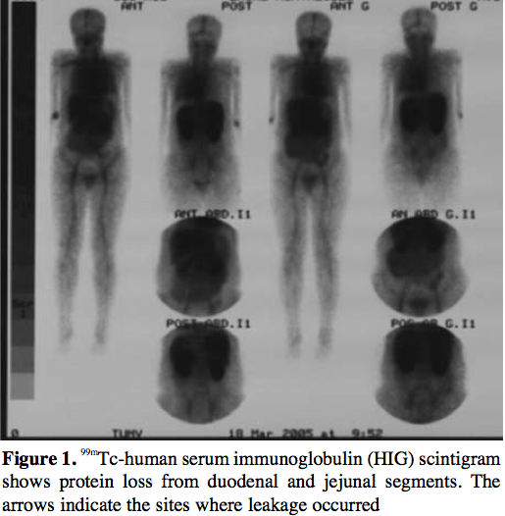
Tc-Human Serum Albumin Scintigraphy

Slide 60
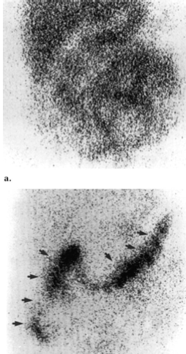
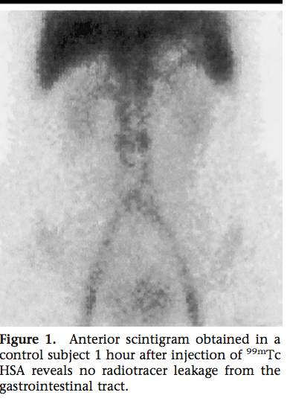
Tc-Human Serum Albumin Scintigraphy
Normal: No leakage

Slide 61
Management of PLE in SLE
Corticosteroids (prednisolone 1mg/kg/day)
Immunosuppresants:
Cyclophosphamide (7-25mg/kg every month x 6mo)
Azathioprine (2-3mg/kg/day)

Slide 62
FINAL DIAGNOSIS
Hypoalbuminemia secondary to Protein Losing Enteropathy
Protein-Losing Enteropathy in Systemic Lupus Erythematosus
s/p 1 dose of Cyclophosphamide
Hyponatremia secondary to Water Excess
Invasive Ductal Carcinoma, left breast
s/p lumpectomy, 6 cycles chemotherapy and radiotherapy (2002)

Slide 63
CONCLUSION
Protein losing enteropathy (PLE): severe hypoalbuminemia and edematous states without overt urinary protein loss, nutritional deficiencies or problems with hepatic synthesis
3 general diagnostic categories of PLE: ulcerative, lymphatic obstruction, non-ulcerative mucosal disease
Workup: endoscopy with biopsy and evaluation of enteric protein loss (Tc-Human Albumin Scintigraphy)
PLE: Primary consideration in patients with rheumatologic diseases with low albumin of uncertain etiology

Slide 64
On follow-up…
3 doses of Cyclophosphamide
Responding well with improvement of edema
Latest albumin: 3.0 g/dL

Slide 65
THANK YOU
AND
GOOD DAY!

Slide 66
Special Thanks To:
Dr. Paolo Lorenzo
Dr. Ernesto Olympia
Dr. Noel Rosas
Dr. Ramon Francisco
Dr. Vanessa Navarro
Dr. Mara Mangio
Dr. Odette Wilson
Sir BJ
Pathology Department: Dr. J. Caduhada, Dr. C. Pacho, Dr. J. Billote
Radiology Department
Endoscopy Unit
To all my batchmates (Trish, Myl, Sandra, Gigi)

