Slide 1
MEDICINE GRAND ROUNDS Hypertrophic Osteoarthropathy: a pretender, a cheater
Margaret Elaine J. Villamayor, RMT, MD
Makati Medical Center
April 8, 2010

Slide 2
Objective
To present a case of a patient presenting with joint pains as a symptom of a distant pathology
Notes:
And I’m here to present a case of a patient presenting with joint pains as a symptom of an underlying pathology

Slide 3
GENERAL DATA
EB, 52/male, married,
Filipino, Engineer, admitted last January 13, 2010
Notes:
Our px is EB, a 52 yr old man, who was admitted in our institution last January 13, 2010

Slide 4
CHIEF COMPLAINT
Joint pains
Notes:
Patient came in w/ a chief complaint of joint pains

Slide 5
HISTORY OF PRESENT ILLNESS
2 months
Intermittent pain on tibial & ankles, sharp, deep-seated, 5/10, not related to physical activity, no specific timing and lasting more than 30 minutes
Self-medicated : Ibuprofen and Meloxicam

Slide 6
HISTORY OF PRESENT ILLNESS
1 month
Consult: Normal Blood tests
Impression: Gouty Arthritis
Unrecalled pain meds
Diet modification
Notes:
incldu

Slide 7
HISTORY OF PRESENT ILLNESS
2 weeks
(+) pain on wrists, toes
(+) enlargement & pain on fingertips
(+) difficulty in ambulating and with fine movements
(+) sore throat & fever
Consult at MMC

Slide 8
HISTORY OF PRESENT ILLNESS
1 week
On follow-up: (+) increase in pain severity
Advised admission for further workup

Slide 9
REVIEW OF SYSTEMS
General: (-) pallor, anorexia, weight loss
HEENT: (-) signs of head injury, (-) redness, itchiness, lacrimation of eyes, (-) deafness, tinnitus, and ear discharge, (-) colds, nasal stuffiness, epistaxis, (-) mouth sores, sore throat, gum bleeding, (-) stiffness, lumps, tenderness, adenopathy
Respiratory: (-) cough, wheezing, shortness of breath, hemoptysis
Cardiovascular: (-) chest pain, palpitation, syncope, cyanosis
Gastro-intestinal: (-) nausea, vomiting, hematemesis, dysphagia, diarrhea, constipation
Renal: (-) hematuria, no dysuria
Neurologic: (-) fainting
Psychiatric: (-) history of depression

Slide 10
PAST MEDICAL HISTORY
No serious illness during childhood.
No known co-morbidities
Diagnosed with Cholelithiasis in 2006
No history of previous surgeries, blood transfusions, trauma, allergies

Slide 11
FAMILY HISTORY
(+) Gastric CA – father
(+) Colon CA - paternal grandfather

Slide 12
PERSONAL AND SOCIAL HISTORY
36 pack years smoking history
Occasional alcoholic beverage drinker
Denies illicit drug use & multiple sexual partners
Patient works as an engineer in Saudi Arabia for the past 20 years
Plays golf every week.

Slide 13
PHYSICAL EXAMINATION
General Survey: conscious, coherent, oriented to person, place and time, ambulates with assistance
BP 120/80, HR 72 bpm, RR 18 cpm, T 36.9C,
Height: 162cm Weight: 68.18kg BMI: 25. 59kg/m²
HEENT: anicteric sclerae, pink conjunctivae, no naso-aural discharge, no cervical lymphadenopathies, no tonsilopharyngeal congestion, no neck vein distention, no carotid bruits
Chest and Lungs: No gross lesions, no retractions, no point tenderness, equal chest expansion, equal fremiti, lungs resonant, clear breath sounds

Slide 14
PHYSICAL EXAMINATION
Heart: adynamic precordium, AB at 5th LICS MCL, regular rate & rhythm, no friction rub, no murmurs
Abdomen: flabby abdomen, non-distended, normoactive bowel sounds, soft, tympanitic, nontender, no hepatosplenomegaly, no Murphy’s sign, no costovertebral angle tenderness, no peritoneal signs

Slide 15
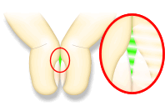
PHYSICAL EXAMINATION
Extremities:
(+) digital clubbing on all extremities
(+)bilateral tibial tenderness, non erythematous, not warm to touch
(+) limitation of movement on wrist & ankle flexion & finger flexion and opposition
(-) cyanosis, crepitus
Shamroth’s test
Notes:
Shamroth’s test/The apposition sign: The distal interphalangeal (DIP) joints and the nail bed of the right and left index finger are placed in apposition. Normally, an oblong diamond-shaped aperture is visible between the 2 juxtaposed nail beds. With clubbing, this space is obliterated.

Slide 16
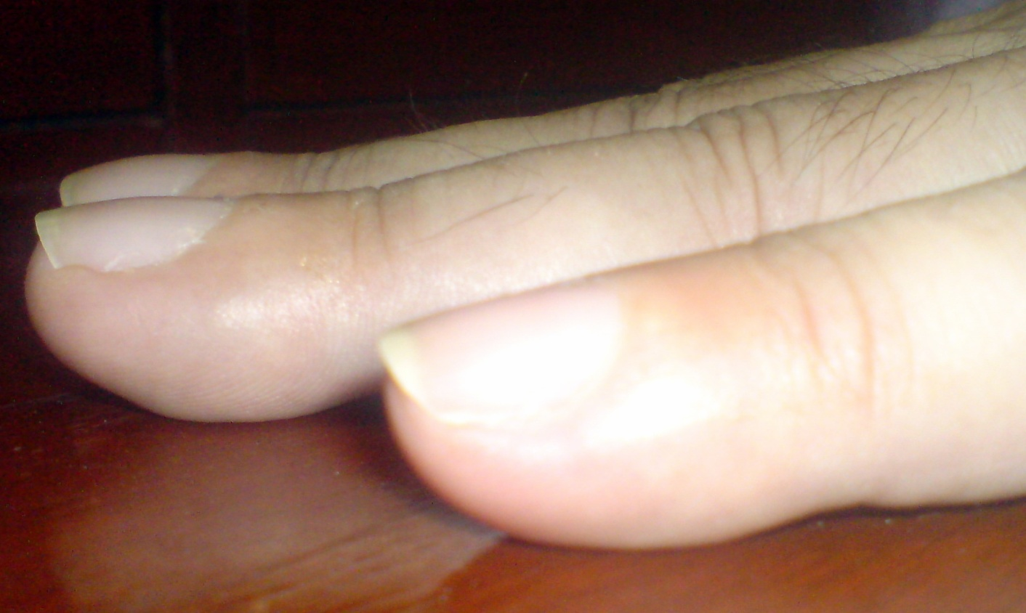
Lovibond angle
Normal Angle = less than or equal to 160°.
Flat/ >180 = clubbing
Swartz MH. Textbook of Physical Diagnosis: History and Examination. 2nd ed. Philadelphia, Pa: WB Saunders; 1994:76-8.
Notes:
the angle made by the proximal nail fold and nail plate (Lovibond angle) typically is less than or equal to 160°. In clubbing, the angle flattens out and increases as the severity of the clubbing increases. If the angle is greater than 180°, definitive clubbing exists. An angle between 160-180° falls in a gray area and may indicate early stages of clubbing

Slide 17
NEUROLOGIC EXAMINATION:
Mental status: awake, alert, oriented
Cranial Nerve Exam:
CN I – not assessed
CN II, III – pupils 3mm ERTL, (+) ROR, clear media, no visual field defects
CN III, IV, VI – full EOMs
CN V – intact V1-V3
CN VII – no facial asymmetry
CN VIII – no gross hearing defects
CN IX, X – tongue and uvula at midline
CN XI – good SCM tone
CN XII – tongue at midline

Slide 18
NEUROLOGIC EXAMINATION
Cerebellar: no dysdiadochokinesia, no dysmetria
Reflexes: +2 on all extremities, no Babinski
Meninges: supple neck, no Brudzinski, no Kernig’s
Motor : 5/5 on all extremities
Sensory: no sensory deficits

Slide 19
SALIENT FEATURES
SUBJECTIVE
36 pack year smoking history
(+) Family History of Cancer
(+) fever, (-) weight loss, cardiac, gastrointestinal or respiratory symptoms
Joint & tibial pain x 2 months - symmetrical, no specific timing, not relieved by rest/ analgesics, >30 mins
OBJECTIVE
(+) digital clubbing both upper and lower extremities
(+)bilateral tibial tenderness

Slide 20
Admitting Impression
t/c Hypertrophic Osteoarthropathy, etiology to be determined
Obese Class I (BMI 25. 59kg/m2)

Slide 21
 | Patient | Rheumatic Fever | Rheumatoid Arthritis | Osteoarthritis | HOA
Systemic sxs | Fever | Fever, sore throat | Weakness, easy fatigability, weight loss, ±fever, | None | ±fever
PE | symmetrical Tibial, wrists, toes digits, wrist, clubbing (-) crepitus | Migratory, carditis, | symmetrical PIP, MCP/MTP, wrist, elbow, knee, ankle, nodules | LS spine, hip, knee, 1st MTP DIP PIP spared are the wrist, elbow, and ankle (+) crepitus | Tibia, wrists, ankles, digits, elbow, clubbing
Timing | ± Movement | ± Movement | Movement, morning , >1 hr | Movement | ± Movement
Notes:
RA: Pain in affected joints, aggravated by movement, is the most common manifestation of established RA. Generalized stiffness is frequent and is usually greatest after periods of inactivity. The majority of patients will experience constitutional symptoms such as weakness, easy fatigability, anorexia, and weight loss. Although fever to 40°C occurs on occasion
OA: OA is joint failure, a disease in which all structures of the joint have undergone pathologic change, often in concert. The pathologic sine qua non of disease is hyaline articular cartilage loss, present in a focal and, initially, nonuniform manner. This is accompanied by increasing thickness and sclerosis of the subchondral bony plate, by outgrowth of osteophytes at the joint margin, by stretching of the articular capsule, by mild synovitis in many affected joints, and by weakness of muscles bridging the joint. In knees, meniscal degeneration is part of the disease. There are numerous pathways that lead to joint failure, but the initial step is often joint injury in the setting of a failure of protective mechanisms

Slide 22
Approach to HOA
Pineda C, Fonseca C, Martinez-Lavin M. The spectrum of soft tissue and skeletal abnormalities of hypertrophic osteoarthropathy. J Rheumatol. May 1990;17(5):626-32.
Notes:
Cervical rib, pancoast tumor, aneurysm of subclavian artery, pre-subclavian coarctation of aorta, AVF involving brachial vessels

Slide 23
Course in the Wards
 | Jan 13
Sodium | 135
Potassium | 4.6
BUN | 10.12
Crea | 0.72
Calcium | 8.78
Total Protein | 6.9
Albumin | 3.6
Globulin | 3.3
A/G | 1.09
ALP | 140
AST | 25
Total Bili | 7.8
Uric Acid | 3.8
Trigly | 56
Chole | 185.57
HDL | 53.78
LDL | 101.76
 | Jan 13
Hb | 12.7
Hct | 37
RBC | 4.42
WBC | 15.25
Seg | 76
Lympho | 16
Mono | 8
Plt | 531,000
 | Jan 13
ESR | 93
CRP | (+)
Notes:
CRP positive up to 1:64 dilutions (384 mg/l)

Slide 24
Xray of Both Hands
No osseous nor joint abnormalities seen in both hands

Slide 25
Chest Xray
Notes:
A mass density measuring about 7.5x6.5cm in its widest dimension is seen in the right parahilar area. The mass has lobulated border with compression of the inferior bronchus. No cavitations, no evident calcification within the lesion. The rest of the lungs are unremarkable

Slide 26
CT-Scan of the Chest: January 13, 2010
Notes:
CT scan of the chest showed 4.6 x 5.5 x 4.6 cm well-defined soft tissue mass in the right hilar region, accompanied by some ground glass opacity changes in the surrounding right upper lung segment (obstructive pneumonitis).

Slide 27
CT-Scan of the Chest: January 13, 2010
Notes:
A small 0.6cm nodule is noted along the peripheral margin of the right middle lobe, emphysematous changes are noted scattered throughout the right and left lungs.

Slide 28
CT-Scan of the Chest: January 13, 2010
Notes:
At least 3 about 1.0 to 1.6 cm nodes are noted in the subcarinal region.

Slide 29
Course in the Wards
TCVS Referral
CT-guided Biopsy
Plan: if NSCLC, mediastinoscopy and possible pneumonectomy of the right lung
Cranial MRI & CT of the Abdomen

Slide 30
Cranial MRI

Slide 31
SMEAR, DIFF-QUIK STAIN, HPO
Notes:
ON THIS slide, neoplastic cells are arranged singly, in small groups and in clusters with glandular formation seen in some areas. The cells are enlarged, pleomorphic and hyperchromatic with occasional prominent nucleoli, with scanty , angulated, eosinophilic cytoplasm. Few inflammatory cells and RBCs are seen in the background.

Slide 32
CELLBLOCK: Right Lung Mass s/p CT-guided Biopsy
Notes:
The cell block shows similar cells as previously described, seen in clusters & in small sheets.

Slide 33
CK7 (+)
Notes:
Immunohistochemical staining are done & disclose tumor cells are focally positive in CK 7 , & negative for CK20.

Slide 34
CK 20 (-)
Notes:
Positive for malignant cells, cytomorphologic features consistent with Non-small cell Cancer
Focally positivity of CK7 favors an Adenocarcinoma.

Slide 35
TTF –1 indeterminate
Notes:
TTF-1 Thyroid Transcription Factor was indeterminate in tumor cells. (some tumor cells, while others doesn’t).
The indeterminate result of TF1 cannot exclude with certainty a squamous and adenosquamous carcinoma. So a CKHMW.

Slide 36
CKHMW (-)
Notes:
Tumor cells was negative for high molecular weight cytokeratin

Slide 37
FINAL DIAGNOSIS
POSITIVE FOR MALIGNANT CELLS
CK 7 (+) POSITIVE, TTF1 INDETERMINATE,
CK 20- NEGATIVE, CKHMW-FOCALLY POSITIVE
SUPPORTS THE DIAGNOSIS OF NON-SMALL CELL ADENOCARCINOMA
Notes:
CYTOMORPHOLOGIC FEATURES CONSISTENT WITH NON-SMALL CELL CARCINOMA

Slide 38
Course in the Wards
Plan:
LN biopsy (+) for malignancy: defer Thoracotomy & proceed with Radiotherapy
LN biopsy (-): Right lung Pneumonectomy and Mediastinal lymph node dissection
Notes:
IIB T2 N1 M0 large tumor, <?> mediastinal & subcarinal ipsi, no mets

Slide 39
PET Scan
Notes:
The accurate assessment of the extent of disease is critical to determine whether the patient is treated by surgical resection, chemotherapy, radiation therapy, or combination of these therapies. PET imaging and integrated PET/CT (positron emission tomography+CT) imaging play an important role in the evaluation of pxs with lung CA.
PET scans use glucose (a form of sugar) that contains a radioactive atom. A special camera can detect the radioactivity. Cancer cells absorb high amounts of the radioactive sugar because of their high rate of metabolism

Slide 40
PET Scan
Enlarged lymph node is present in the right hilum measuring 1.3 cm with mild FDG uptake (SUV 2.0); Mild FDG uptake is also noted in at least 2 unenlarged nodes in the subcarinal area (SUV=2.0, 2.1)
An FDG-avid (SUV 11.0) mass lesion is present in the right hilum measuring 6.5x6.4cm.
Notes:
standardized uptake value (SUV) of >2.5 is highly suspicious for malignancy. Hypermetabolic right hilar mass compatible with the known tumor of the patient. Right hilar lymphadenopathy with low-grade uptake is suspicious for metastasis, Low grade subcarinal nodal uptake is also suspicious but not specific for metastasis

Slide 41
Quantitative Perfusion Imaging
Notes:
This is the Quantitative perfusion scan of our patient done on January 27,2010. Intravenous injection of Technetium 99m-macroaggregated albumin was done prior to the scan. Film shows a Right/Left Lung ratio of 47/53 in anterior view (0.9) ; and 46/54 in posterior view (0.84). Values fall below the acceptable right /left lung ratio (N= 52.5/47.5 +/- 2.1% or 1.1) . Preoperative analysis of relative right to left lung ratio reveals essentially asymmetric function with the left lung contributing more than the right lung.

Slide 42
Perfusion Scan
Notes:
Static images show non-segmental perfusion defects at the hilar and upper regions of the right lung, the rest of the lungs show satisfactory and fairly uniform distribution of radioactivity. Non-segmental defects may suggest tumors, trauma, hemorrhage, bullae, mediastinal and hilar adenopathy, atelectasis, penumonia, and aortic ectasia or aneurysm. Other causes which is most likely not present in our patient are pacemaker artifact, pleural effusion, cardiomegaly.

Slide 43
Course in the wards
February 6, 2010
Mediastinoscopy with Frozen Section and possible right pneumonectomy with mediastinal lymph node dissection.

Slide 44
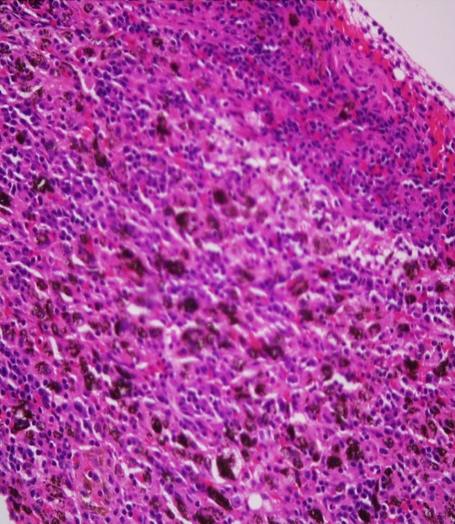
OR Findings
Bronchoscopic findings: carina & main bronchi free of tumor, slight narrowing of right upper lung bronchus,
Frozen section of the Right tracheobronchial mediastinal lymph node was negative for metastasis.
Notes:
Frozen Section shows fibrocollagenous tissue infiltrated with carbon-laden macrophages admixed with lymphoid cells in clusters in different maturation. No evidence of malignancy is seen in this submitted specimen.

Slide 45
OR Findings
Exploration revealed a central tumor encompassing all 3 right lung lobes with some enlarged lymph nodes.

Slide 46
Intraoperative Status
Patient was noted to have desaturation 84% on 100% FiO2
Elevation of mean PA/Swan Ganz
Consistently observed with single lung ventilation
Pneumonectomy was aborted
Section biopsy of the right hilar node done.

Slide 47
CT-Scan of Chest
Jan. 14, 2010
Feb. 15.2010
Notes:
: comparative study 7.3 x 7.3 x 7.0 cm appearing more cystic/necrotic than before. Accompanying right paratracheal – precarinal lymph node is noted measuring 2.2cm. the subcarinal/right hilar rods remain unchanged. There is again note of another mainly cystic “nodule” posterior to the above along the right lung fissure measuring 4 cm greatest axial diameter subcm pulmo nodule remain unchanged. Now with minimal right sided pleural effusion, pleural calcification seen.

Slide 48
Course in the Wards
Referral Oncology and Radio-Onco
Induction chemotherapy with radiation therapy
Notes:
For unresectable stage II non-small cell lung cancer, combined thoracic radiation therapy and cisplatin-based chemotherapy reduces mortality by about 25% at 1 year. Unresectable non small cell cancer, radiation tx + addition of a cisplatin/taxane based chemo may reduce death risk by 13% at 2 yrs and improve quality of life
SMALL CELL: combination chemois standard mode of tx, response after 6-12 wks predicts median and long-term survival. Addition of radio to chemo

Slide 49
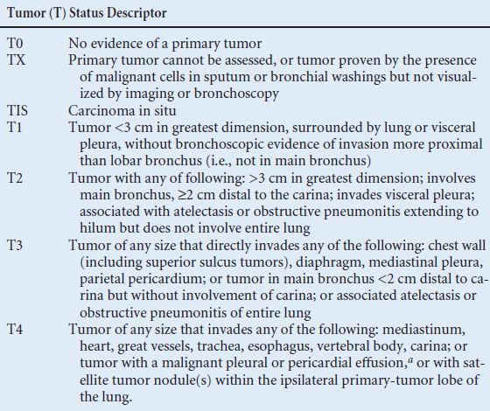
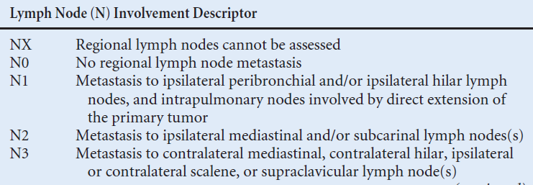
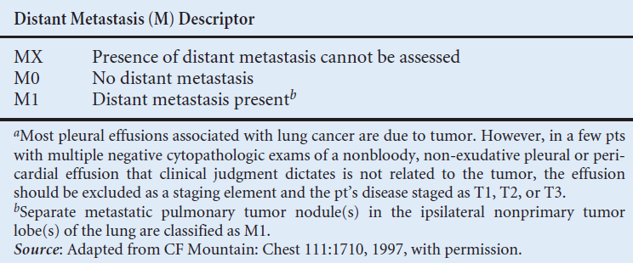
STAGING
Notes:
T3 large lung mass w/ obstuctive pneumonitis, subcarinal suspicous of malignancy on PET scan, absence of distant metastasis

Slide 50
STAGING
Non-Small Cell Lung Adenocarcinoma Stage IIIA

Slide 51
FINAL DIAGNOSIS
Non-Small Adenosarcinoma Lung Carcinoma Stage IIIA
Hypertrophic Pulmonary Osteoarthropathy secondary to malignancy

Slide 52
DISCUSSION
Hypertrophic Osteoarthropathy

Slide 53
Notes:
The incidence of HOA is so small that only a few cases have been reported in literature. Most of them have similar clnical presentation of arthritic-like pains on the joints & tibial area and clubbing.

Slide 54
Diagnostic Criteria
Clubbing, Joint Pains, Periostosis of the tubular bones
Three other forms of hypertrophic osteoarthropathy are described:
clubbing alone
periostosis without clubbing in the setting of an illness known to be associated with hypertrophic osteoarthropathy, and
pachydermia associated with minor manifestations
Martinez-Lavin M, Matucci-Cerinic M, Jajic I, Pineda C. Hypertrophic osteoarthropathy: consensus on its definition, classification, assessment and diagnostic criteria. J Rheumatol. Aug 1993;20(8):1386-7
Notes:
In an article written by the of Martinez-Lavin in the Journal of Rheumatology….
(eg, synovial effusion, seborrhea, folliculitis, hyperhidrosis, hypertrophic gastropathy, acroosteolysis).

Slide 55
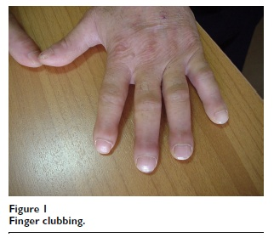
Hypertrophic Osteoarthropathy
Bilateral and symmetric
It may occur as a primary condition, which is familial and affects mainly males
90% of secondary cases are associated with intra-thoracic pathology
Notes:
90% of secondary cases are associated with intra-thoracic pathology so the syndrome is often called HPOA

Slide 56
Hypertrophic Osteoarthropathy
HPOA has only been reported in 1–10% of cases of Lung carcinomas
Among these, HPOA is most commonly found with Non–small cell lung carcinoma
Sridhar KS, Lobo CF, Altman RD. Digital clubbing and lung cancer. Chest. Dec 1998;114(6):1535-7.

Slide 57
Clinical Presentation
Mild to severe arthralgias on metacarpal joints, wrists, elbows, knees, ankles.
Range of motion of affected joints may be slightly decreased
When effusions are present, they usually involve the large joints (eg, knees, ankles, wrists).

Slide 58
Hypertrophic Pulmonary Osteoarthropathy
The occurrence of HPOA without clubbing of the digits is so rare as to be published only in as few as four case reports in the past 10 years.
It is more common with large central tumors than peripheral tumors, with no predilection for cell type

Slide 59
Hypertrophic Pulmonary Osteoarthropathy
It is a general conception that the malignant neoplasms associated with HPO are primary in the lung and that metastatic tumors to the lungs are rarely associated with HPO.

Slide 60
Hypertrophic pulmonary osteoarthropathy (HPOA)
The pulmonary lesions were generally larger than 5 cm
However, in some cases, the major mass lesion was located in the lower lobes of the lung & was in direct contact with the pleural surfaces, either anteriorly or diaphragmatically

Slide 61
Pathophysiology
Exact mechanism of the syndrome is still unclear.
Notes:
This theory did not gain acceptance and does not feature in standard texts. It was suggested that megakaryocytes bypass the pulmonary circulation through arteriovenous shunting and escape fragmentation ➔ platelet derived growth factor (PDGF) & vascular endothelial growth factor (VEGF) by endothelial cells ➔ resulting in angiogenesis and endothelial hyperplasia ➔ clubbing of fingers and toes

Slide 62
Other secondary causes
Pulmonary Tuberculosis
Congenital Cyanotic Heart Disease
Hepatic and Colorectal Carcinoma
Inflammatory Bowel Disease
Cirrhosis
Pulmonary Fibrosis and Empyema
Notes:
These are other secondary causes of HOA

Slide 63
Whole-body bone scintigraphy
Preferred method for diagnosing the syndrome
Increased tracer uptake along the cortical margins of the bilateral lower extremities, which is compatible with the “parallel stripe” sign or “tramline” sign
Notes:
Pericortical uptake involving the long bones of the lower limbs. Thicker, more extensive alterations are indicative of long-standing disease. The periostitis of HOA is not dependent on the primary or secondary nature of the disease but principally on its duration.

Slide 64
HPOA vs Metastasis on Bone Scan
Notes:
HPOA: Diffuse increased uptake along the margins of the long bones. The cardinal features of skeletal metastatic disease are multiple focal areas of increased MDP uptake, randomly distributed but favoring the axial skeleton, with asymmetric involvement.

Slide 65
HPOA diagnosed by FDG PET-CT: a case report
The CT portion : extensive irregular bilateral periosteal new bone formation in the long bones.
The PET images : diffuse moderately increased FDG uptake in the periostea of the long bones of the legs, with some focal sites of more intense FDG uptake in the thicker portions of the periosteum.

Slide 66
Digital Clubbing : Demonstration With PET: A Case Report
The PET scan revealed increased glucose metabolism in all of the patient's fingertips
Ward RW, Chin R Jr, Keyes JW Jr, Haponik EF. Digital clubbing. Demonstration with positron emission tomography. Chest. Apr 1995;107(4):1172-3.
Notes:
An increased signal, indicating increased glucose metabolism, has been demonstrated in the distal part of the clubbed fingers. These changes are not seen in fingertips with normal morphology.
The increase in signal supports the theory that clubbing is caused by the presence of a factor (eg, platelet-derived growth factor) that increases cellular metabolism

Slide 67
Treatment
The only effective treatment for HPOA is treatment of the underlying condition
Atropine, antitumor chemotherapy
In patients with HPOA, tumor resection often results in improvement of symptoms within 2 to 4 weeks and, sometimes, complete resolution by 3 to 6 months

Slide 68
Effective Symptomatic Relief of HPOA by VATS Vagotomy
Relief of all joints and she regained full range of movements within 24 hours
Discharged on the third post-op day and remained pain free and fully mobile 3 months after the surgery.
Martinez-Lavin M: Hypertrophic osteoarthropathy. Curr Opin Rheumatol 1997;9:83– 6.
Notes:
Surgical vagotomy had been effective in providing symptomatic relief when the lung tumor proved unresectable.
Clinical examination found classic clubbing with red, warm, and enlarged tender terminal phalanges of both hands and feet. She had painful and limited range of movement of both knees and ankles. normal except for a raised erythrocyte sedimentation rate.
Relief of all joints, and she regained full range of movements within 24 hours.
Discharged on the third post-op day and remained pain free and fully mobile 3 months after the surgery.

Slide 69
Current Status:
At present, patient finished 33 sessions of radiotherapy and is on his 5th cycle of chemotherapy
Patient still experiences intermittent joint pains but lesser in severity

Slide 70
Thank You!

Slide 83
Hypertrophic Osteoarthropathy on Xray
The periostium of the ends of long bones are elevated
Periosteal new bone formation gives rise to the appearance called as “Sun-Rise” appearance

Slide 84
PET vs Bone Scan in Detecting NSCLC Metastasis
Patients and methods:
April 2004 - May 2007, retrospectively reviewed to identify all patients with newly diagnosed NSCLC and who underwent staging with both PET/CT and bone scan prior to the initiation of therapy.
Presence of bone metastases was confirmed by considering all available clinical information.
This search identified 1000 patients, 265 women and 735 men (age range, 18–89 years; median age, 65 years).

Slide 85
PET vs Bone Scan in Detecting NSCLC Metastasis
Results
Bone metastases were confirmed in 105 (10.5%) patients.
 | PET/CT | Bone Scan | p value
Accuracy | 98.3% | 95.1% | <0.001
Sensitivity | 94.3% | 78.1% | 0.001
Specificity | 98.8% | 97.4% | 0.006
False (+) | 1.2% | 2.9%
False (-) | 5.7% | 21.9%

Slide 86
Hypertrophic pulmonary osteoarthropathy diagnosed by FDG PET-CT: a case report
The CT portion : extensive irregular bilateral periosteal new bone formation in the long bones.
The PET images : diffuse moderately increased FDG uptake in the periostea of the long bones of the legs, with some focal sites of more intense FDG uptake in the thicker portions of the periosteum.

Slide 87
 | Patient | Rheumatoid Arthritis | Osteoarthritis | Acute Rheumatic Fever | HOA
Joints | Tibial area, digits, wrist | PIP, MCP/MTP, wrist, elbow, knee, ankle | Knees, hips | Migratory polyarthritis | Tibia, wrists, digits, elbow
Systemic symptoms | fever | Weakness, easy fatigability, anorexia, weight loss, ±fever, nodules | None | Fever, sore throat | ±
Timing | ± Movement | Movement, morning , >1 hr |  |  | No specific timing
Labs | ↑ acute phase reactants | (+) RF, elevated acute phase reactants
Radio findings | Normal Hand Xray | erosions or unequivocal bony decalcification |  |  | Normal/
Notes:
RA: Pain in affected joints, aggravated by movement, is the most common manifestation of established RA. It corresponds in pattern to the joint involvement but does not always correlate with the degree of apparent inflammation. Generalized stiffness is frequent and is usually greatest after periods of inactivity. Morning stiffness of >1-h duration is an almost invariable feature of inflammatory arthritis. Notably, however, the presence of morning stiffness may not reliably distinguish between chronic inflammatory and noninflammatory arthritides, as it is also found frequently in the latter. The majority of patients will experience constitutional symptoms such as weakness, easy fatigability, anorexia, and weight loss. Although fever to 40°C occurs on occasion, temperature elevation in >38°C is unusual and suggests the presence of an intercurrent problem such as infection.

Slide 90
Articular manifestations of hypertrophic pulmonary osteoarthropathy in bronchogenic carcinoma. A clinical and pathologic study
Eight patients with bronchogenic carcinoma presented with painful joint effusions as part of the syndrome of hypertrophic osteoarthropathy.
Elevated sedimentation rates and symptomatic relief with aspirin were common, but synovial fluids all had leukocyte counts less than 500/mm³.
.

Slide 91
Clubbing usually progresses through 4 phases.⁸
Fluctuation and softening of the nail bed, with a rocking sensation upon palpation due to increased edema and soft tissue
Loss of the normal 15° angle (Lovibond angle²⁷ ) between the nail and cuticle
Accentuation of the convexity of the nails and clubbed appearance of the fingertips, with warmth and sweating
Shiny or glossy change in the nail and adjacent skin, with disappearance of the normal creases and appearance of longitudinal striation of the nail
Clubbing can be classified into 3 topographical groups.^{28,29}
Symmetrical: All the fingers and toes are involved, as depicted in the image below.
Clubbing associated with hypertrophic osteoarthropathy can be classified into 3 topographical groups (ie, symmetrical, unilateral, unidigital). This is symmetrical clubbing; it involves all the fingers and toes.
[ CLOSE WINDOW ]
Clubbing associated with hypertrophic osteoarthropathy can be classified into 3 topographical groups (ie, symmetrical, unilateral, unidigital). This is symmetrical clubbing; it involves all the fingers and toes.
Unilateral: The fingers or toes of 1 hand or foot are involved.
Unidigital: Only 1 finger or toe is involved.

Slide 92
Immunohistochemistry
Braunwald, Fauci, Harrison’s Internal Medicine 17th edition, 2009

Slide 94
Pre-operative Testing
ABG | Jan 26
pO2 | 96.2
pH | 7.50
pCO2 | 34
HCO3 | 26.3
O2 Sat | 97.9
Base Excess | +3.6
 | Room air
 | PRED | Pre-Rx |  | Post-Rx
 |  | Best | % Pred | Best | %Pred | %Change
FVC | 3.05 | 3.25 | 106 | 3.15 | 103 | -3
FEV1 | 2.41 | 2.49 | 103 | 2.55 | 106 | 2
FEV1/FVC% | 82 | 77 | 93 | 81 | 98 | 5
FEF 25-75% | 3.03
DLCO |  | 14.3 | 66
MVV | 130 | 74 | 57 | 55 | 42 | -26
Notes:
The FEV1/FVC ratio w/ a normal FVC. The FEV1 and & fev1 25-75% are normal. The mvv is low. No signif response to bronchodilator. The tlc & rv are decreased. The dlco mildlt reduced.
Spiromtery compatible w/ a restrictive ventilatory defect. The diffusing capacity is mildly is reduced.

Slide 95
Jones Criteria for Rheumatic Fever
MAJOR CRITERIA | MINOR CRITERIA
Carditis Migratory polyarthiritis Sydenham’s chorea Subcutaneous nodules Erythema marginatum | Clinic Fever Arthalgia Laboratory Acute Phase Reactants Prolonged PR interval
PLUS Supporting evidence of a recent Group A streptococcal fever
GABHS + 2 major and 1 minor criteria, or 1 major and 2 minor criteria
carditis or chorea exists with no other cause,
previous history of rheumatic fever who have 1 major or 2 minor criteria in association with a recent streptococcal infection.
Notes:
Increased antistreptolysin O or other streptococcal antibodies
Positive throat culture for Group A beta-hemolytic streptococci
Positive rapid direct Group A strep carbohydrate antigen test
Recent scarlet fever.
\

Slide 98
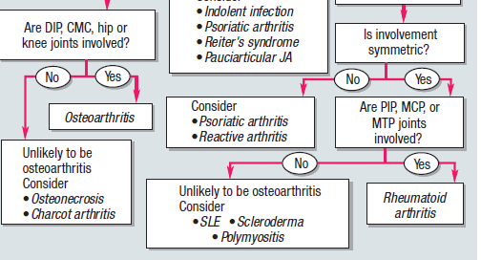

Slide 99
Periostitis in HOA
Primary HOA and congenital heart disease-associated HOA had multilayered periostitis vs Lung-cancer HOA, there was only a single layer
Scores indicating severity of periostitis showed that a severe degree was present in a significant percentage of patients with both primary HOA and CCHD-associated HOA compared to HPOA
Pineda, Martinez, Periostitis in Hypertrophic Osteoarthropathy: relationship to disease duration
Notes:
The most common type of periostitis observed in patients with primary HOA and congenital heart disease-associated HOA was multilayered; an irregular pattern of periostitis was present in one-third of these patients

Slide 100
Periostitis in HOA
In our seven patients with lung-cancer HOA, less prominent periosteal changes were noted in a more limited distribution.
Malignancy-associated HOA, a disease process of much shorter duration, the natural evolution of the osseous changes cannot fully be expressed.
Notes:
When radiographs were analyzed according to disease duration, they found no significant differences between this group of patients and those with primary and CCHD-associated HOA; these observations suggest that the duration of the disease is most important in determining the distribution and morphology of the skeletal changes.

Slide 101
Periostitis in HOA

Slide 102
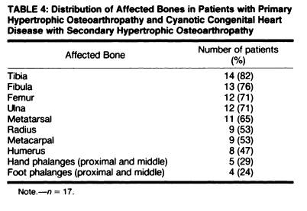

Slide 103
Notes:
4 of 7 = our px was only to

Slide 104
Prediction of Hypoxemia during OLV
Side of Operation
Lung Function Abnormalities
“Paradoxical effect”
Distribution of Perfusion
Central vs Peripheral
Gravity

