Slide 1
“The Battle of an Iron Lady”
Mary Violet B. Zaldarriaga, M.D.
Luz A. Gamez, M.D.
Moderator

Slide 2
Objective:
To present a case of hemochromatosis , its complications and treatment options

Slide 3
General Data
M.R.
87 year old female
married
Makati City

Slide 4
Chief complaint
melena

Slide 5
History of present Illness
Two weeks prior to admission (PTA),
(+) bloatedness
decrease frequency in bowel movement
Several days PTA,
Increase in abdominal girth
Few hours PTA,
Passage of tarry stool
Admission

Slide 6
Review of systems
No fever
No cough
No dizziness
No arthralgia
No skin pigmentation

Slide 7
Past Medical History
Hemochromatosis x 13 years
Abnormal liver function test 1997,
very high ferritin level,
serum iron normal,
iron saturation high
Platelet count, prothrombin time, albumin normal
Liver biopsy

Slide 8
CT guided liver biopsy
Hepatocytes display abundant accumulations of iron pigment (Prussian blue stain)
Increased amounts of fibrosis in the portal tracts but bridging fibrosis and cirrhosis not seen

Slide 9
Past Medical History
Therapeutic phlebotomies
weekly 500cc WB for 18-24 months
Iron saturation every 3 months in 1st year
Goal: monitor iron saturation to low normal range
Screened yearly for AFP and ultrasound of liver

Slide 10
Past Medical History
June 2006
Ultrasound whole abdomen small hepatic cyst, right lobe
Serum iron=115ug/dL (20-160)
TIBC=398ug/dL (230-520)
Transferrin saturation 29% (20-60)
Ferritin=136ng/mL (5-114)
AFP=1.93ng/mL (less than 10)
Maintenance phlebotomy

Slide 11
Past Medical History
Diabetes Mellitus x 20 years
Hypertension x 30 years
Parkinson’s Disease x 14 years
Post CVA
s/p Appendectomy

Slide 12
Physical Examination
Awake, conscious, conversant
BP=120/60, HR=96bpm, RR=17cpm, T=36.4’C
Anicteric sclera, pale pink conjunctiva
Supple neck, no cervical lymphadenopathy, no masses palpated
JVP at 7cm, no carotid bruit
No spider angiomata
Symmetrical chest expansion, equal tactile fremitus, clear breath sounds
quiet precordium, apex beat 4th ICS left midclavicular line, regular rate and rhythm, no murmurs

Slide 13
Physical Examination
Abdomen globular, no caput medusae, hypoactive bowel sounds, tympanitic, soft, nontender
Rectal examination: tight sphincteric tone, no masses, no tenderness, (+) green stool
(+) grade 1 bipedal, pitting edema

Slide 14
Impression
Gastrointestinal Bleeding, Etiology (?)
Hemochromatosis
Diabetes Mellitus
Hypertension
Parkinson’s Disease
post CVA

Slide 15
Course in the wards
1st HD
NPO
IV fluid started
Proton pump inhibitor
CBC

Slide 16
CBC
Parameter | Result | Normal values | unit
Hemoglobin | 7.60 | 12.3-15.3 | g/dl
Hematocrit | 23.10 | 35.9-44.6 | %
RBC | 2.56 | 4.5-5.1 | x10^6/uL
WBC | 9.33 | 4.4-11.0 | x10^3/uL
Basophil | 1.0 | 0-1 | %
Eosinophil | 3.0 | 0-4 | %
Segmenter | 66 | 40-70 | %
Lymphocyte | 22 | 22-43 | %
Monocyte | 8.0 | 0-7 | %
Platelet count | 219,000 | 150,000-450,000 | /uL

Slide 17
Laboratories
Fecal Occult Blood Test
PTT
PT
PTT |  | 25.1-33.9seconds
Patient | 35.60
Control | 27.20
PT |  | 10.6-13.3seconds
Patient | 16.70
Control | 11.90
INR | 1.40 | Less than 1.4
Activity | 54.40 | 70-100%

Slide 18
PARAMETER | Result | Normal Values
Alkaline Phosphatase | 99 | 35-105U/L
SGOT | 46 | 10-35U/L
SGPT | 16 | 10-35U/L
GGT | 182 | 6-42U/L
Total Bilirubin | 0.30 | 0-1mg/dL
Uric Acid | 5.31 | 2.4-5.7mg/dL
LDH | 169 | 135-214U/L
CPK | 60 | 26-192U/L
Amylase | 45 | 28-100U/L
Albumin | 2.80 | 3.5-5.2g/L

Slide 19
Course in the wards
CT of the whole abdomen without contrast
Impression:
Moderate ascites
Liver Cirrhosis with multiple dense calcifications in the right hepatic lobe which may be due to a previous infection
Cholecystolithiases
Mildly atrophic pancreas
Bilateral adrenal gland adenomas considered

Slide 20
Course in the wards
CT of the whole abdomen
Normal non contrast CT scan of the spleen, kidneys, urinary bladder, and visualized gastrointestinal tract
Atherosclerotic disease of the visualized coronary vessels, visualized aorta and its tributaries
Thoracic spondylosis
Minimal right sided pleural effusion

Slide 21
Laboratories
PARAMETER | Result | Normal Values
TIBC | 160.50 | 250-450ug/dL
Ferritin | 411.20 | 13-150ng/mL
Serum Iron | 65 | 37-145ug/dL
AFP | 1.51 | <8.6ng/mL
CEA | 3.22 | 0-3.8ng/mL
CA19-9 | 31.15 | 0-39U/L

Slide 22
Course in the wards
5th HD
Passage of tarry stools
EGD
Esophageal varices grade 2-3
s/p Rubber band ligation,
Portal Gastropathy,
Duodenal Ulcers Forrest Classification IIA, s/p Epinephrine Injection with heat probe therapy

Slide 23
Colonoscopy
Melanosis coli,
nonspecific colitis
Internal Hemorrhoids Grade I,
Anal tag

Slide 24
Course in the wards
7th HD
Patient with abdominal pain,
no bowel movement but with flatus
Abdomen distended, hypoactive bowel sounds, abdominal girth 101.5cm from 97.5cm
PFA : no pneumoperitoneum, no mechanical obstruction
CBC: Leukocytosis : Meropenem

Slide 25
PARAMETER | 1ST HD | 4th HD | 5th HD | 7th HD | Normal Values
Hgb | 7.60 | 14.80 | 14.40 | 12.10 | 12.3-15.3g/dL
Hct | 23.10 | 42.40 | 42.20 | 35.90 | 35.9-44.6%
RBC | 2.56 | 4.89 | 4.79 | 4.03 | 4.5-5.1x10^6/uL
WBC | 9.33 | 4.42 | 5.31 | 14.24 | 4.4-11.0x10^3/uL
Basophil | 1.0 | 1.0 | 2.0 | 0 | 0-1%
Eosinophil | 3.0 | 1.0 | 6.0 | 0 | 0-4%
Segmenter | 66 | 75 | 58 | 86 | 40-70%
Lymphocyte | 22 | 17 | 21 | 6.0 | 22-43%
Monocyte | 8.0 | 6.0 | 13 | 8.0 | 0-7%
Platelet Count | 219,000 | 150,000 | 130,000 | 218,000 | 150,000-450,000/uL

Slide 26
Course in the wards
8th HD
awake, conversant
minimal stool per rectal tube, with abdominal pain
Abdomen distended, tympanitic abdominal girth 92.5cm from 101.5cm, nontender
Serum Amylase

Slide 27
PARAMETER | 1st HD | 8th HD | 9th HD | Normal Values
Alkaline Phosphatase | 99 | 79 | 85 | 35-105U/L
SGOT | 46 | 126 | 70 | 10-35U/L
SGPT | 16 | 98 | 69 | 10-35U/L
GGT | 182 | 191 | 170 | 6-42U/L
Total Bilirubin | 0.30 | 3.85 | 4.28 | 0-1mg/dL
Uric Acid | 5.31 | 3.59 | 4.31 | 2.4-5.7mg/dL
LDH | 169 | 376 | 335 | 135-214U/L
CPK | 60 | 219 | 106 | 26-192U/L
Amylase | 45 | 1,583.0 | 368 | 28-100U/L
RBS | 56.29 | 115.76 | 354.37 | 70-110mg/dL
Cholesterol | 170.10 | 170.10 | 158.51 | <200mg/dl
iCa |  | 1.16 |  | 1.12-1.32meq/L

Slide 28
Diagnosis:
Upper Gastrointestinal Bleeding secondary to Esophageal Varices,
s/p Rubber Band Ligation,
Gastic Ulcer Forrest Classification II
Hemochromatosis with secondary Liver Failure
Acute Pancreatitis improving
Diabetes Mellitus, insulin requiring
Hypertension
CVA

Slide 29
Course in the wards
9th HD
Patient discharged against medical advice

Slide 30
Hereditary Hemochromatosis
Autosomal recessive disorder
Hemochromatosis gene (HFE)
HFE gene on chromosome 6
Involved in iron homeostasis
HFE protein normally limits amount of iron uptake by gut and regulates amount of iron stored in the tissues
mutations produce altered HFE protein unable to properly regulate iron metabolism - results in an excess of iron storage in tissues

Slide 31
Prevalence of Hereditary Hemochromatosis
Most common single gene disorder in whites: Approximately 1/200 are homozygous and 1/10 are carriers.
Latinos: 1/3,700
Blacks: 1/7,100
Pacific Islanders: 1/8,300
Asians: 1/2.5 million

Slide 32
History
An ancient disease, but first described in the 19th century.
1935: Characterized as a hereditary disorder associated with excess iron deposition in tissues.
1970s and 80s: Autosomal recessive mode of inheritence linked to Chrom 6
1996: HFE, “the hemochromatosis gene” is isolated.

Slide 33
PATHOPHYSIOLOGY
is characterized by increased absorption of iron
Patients with Hemochromatosis absorb 2 to 4 mg of iron/day (normal 1 mg/day in males)
The retention of 3 mg of iron/day will lead to net iron accumulation of approximately 1 g/yr
Clinical manifestations often occur after age 40 OR when stores are 15-40 g

Slide 34
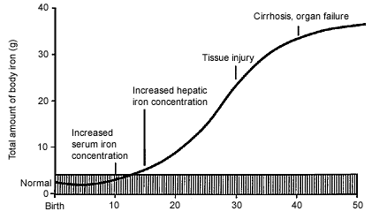
Course of Hemochromatosis
Adapted from Riely CA, Vera SR, Burrell MI, Koff RS. Inherited liver diseases. AGA clinical teaching project: unit 8. Bethesda, GastroenMd.: American terological Association, 1993.

Slide 35
Non-Specific Symptoms and Signs
Liver: hepatomegaly, elevated liver enzymes
Cardiac: arrhythmias, cardiomyopathy
Endocrine: impotence/amenorrhea, diabetes
Musculoskeletal: arthritis/arthralgia
Generally not evident until 40-60 years of age

Slide 36
Clinical Manifestations
Classic triad
cirrhosis,
DM, and
skin pigmentation
occurs late in the disease, when the total body iron content has reached as high as 20 g (> that five times normal)
Approximately 75% of patients are asymptomatic at presentation

Slide 37
Liver Involvement
Progressive iron deposition is associated
hepatomegaly,
elevated liver enzymes, and
the eventual development of cirrhosis
Reversibility with iron removal is more likely early in the course of the disease

Slide 38
Prognostic factors for hepatocellular carcinoma in genetic hemochromatosis. Hepatology 1994 Dec;20(6):1426-31
152 homozygotes were studied prospectively for 1 to 229 months
At diagnosis, cirrhosis was present in 97 patients and absent in 55
During follow-up, hepatocellular carcinoma developed in 28 of the 97 (28.8%) patients with cirrhosis but in none of those without
The risk was increased significantly in patients > 55 yrs, those with HBS Ag and alcohol abuse

Slide 39
Diabetes Mellitus
Prevalence of genetic haemochromatosis among diabetic patients. Lancet 1989 Jul29;2(8657):233
Prevalence of the DM was investigated in 418 patients attending a diabetic clinic
21 (5%) patients had a persistently high serum ferritin and 5 of these had transferrin saturations consistently over 55%
Hereditary Hemochromatosis (HH) was confirmed by liver biopsy in 4
The estimated prevalence was 0.96%, twice that in the general population
Screening of diabetic patients for HH may be more cost-effective than screening in the general population

Slide 40
Cardiac Manifestation
Kraml P, Ferritin, oxidative stress and coronary atherosclerosis (March 2004)
“ high stored iron levels, measured by serum ferritin concentrations, may contribute to the oxidative stress and thus elevate the risk for development of CVD.”

Slide 41
DIAGNOSIS
Fe studies
serum Fe
TIBC / % transferrin saturation
ferritin
Liver biopsy
iron stain
DNA testing

Slide 42
Diagnosis
Transferrin saturation:
> 45% indicates significant Fe accumulation
Serum ferritin - levels indicating significant iron accumulation:
>200 mcg/L pre-menopausal women
>300 mcg/L post-menopausal women
>300 mcg/L for men
Liver biopsy if ferritin >1000 to assess damage
Consider genetic testing – DNA testing for common mutations (C282Y, H63D)

Slide 43
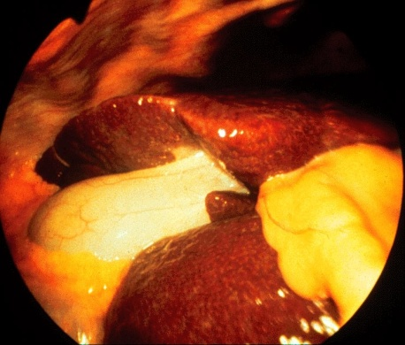
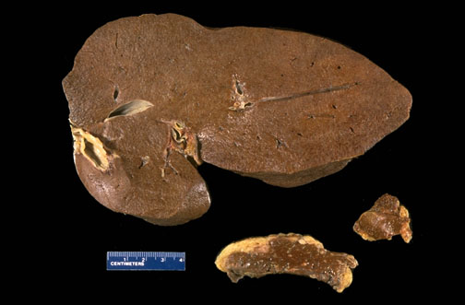
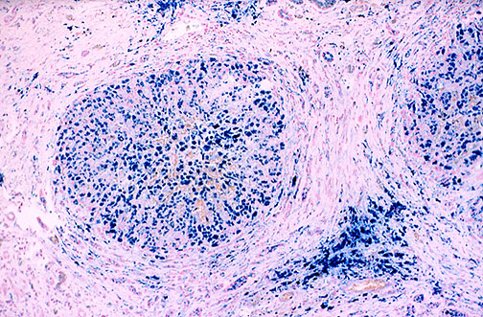
The liver surface of this case shows granular change, suggesting the presence of a fine nodular formation in liver histology.
The blue-stained iron deposits typically start at the periphery of the liver lobule and extends centrally.

Slide 44
Genetic Testing
To confirm diagnosis
Sequential screening of family members
Family members with identified mutations can be offered:
Screening plan to monitor for iron overload.
Normal life expectancy if diagnosed before DM or cirrhosis
Treatment plan to prevent further organ damage, morbidity & mortality.
Prolonged survival with serial phlebotomy
Goal of ferritin <50 may take > 1 year
Environmental modification
Diet, alcohol

Slide 45
Treatment
Phlebotomy
Each 500 mL of whole blood discarded contains 200 to 250 mg of iron
The optimal regimen for phlebotomy in HH has not been established
Do weekly until iron depletion
Hgb < 120
Ferritin < 50
Transferritin saturation < 50%
2-3 years may be required to remove >20g
Long term maintenance about once every 3 months

Slide 46
Treatment
“ Cost-utility analysis of deferasirox compared to standard therapy with desferrioxamine for patients requiring iron chelation therapy in the United Kingdom.”Karnon J 2008 April.
Deferasirox is cost-effective compared to standard iron chelation therapy with desferrioxamine, due to the cost and quality of life benefits derived from a simpler and more convenient oral mode of administration.

Slide 47
Prognosis
Hemochromatosis patients with diabetes had a 10 year survival of 65% compared to 90% in nondiabetics.
The 10-year survival of hemochromatosis subjects with cirrhosis was 72% compared to 82% in the noncirrhotics.
Very heavy iron overload that could not be depleted within 18 months from the onset of therapy was also associated with decreased survival.
Wintrobe’s Clinical Hematolgy.11th ed. 1994.

Slide 48
Summary
Hereditary Hemochromatosis is an autosomal recessive disorder in which mutations in the HFE gene cause increased iron absorption and deposition of excessive amounts of iron in many organ systems.
Diagnosis can be made with serum iron studies, liver biopsy and gene testing.
Treatment options include phlebotomy , chelation therapy, and environmental modification.
HH Goal: detect and treat affected individuals before signs of organ damage occur.

Slide 49
Thank you

