Slide 1
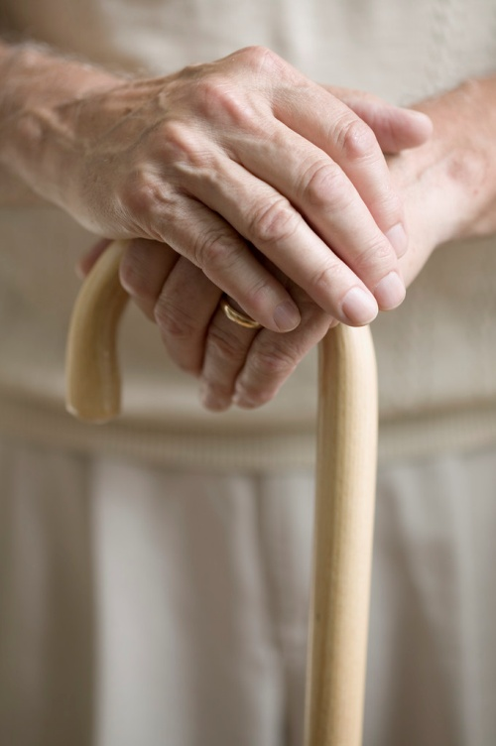
The Frail Elderly
Marian G. Suarez, MD

Slide 2
WORLD DEMOGRAPHICS
Majority of older persons reside in developing countries
2020: expected to have >1 billion persons are ≥60y.o.

Slide 3
World Demographics (WHO; US Bureau of Census)
1990’s half of older people reside in four countries: China, India, former USSR and USA
From Global Aging: Comparative Indicators and Future Trends, U.S. Department of Commerce, Economics and Statistics Administration, Bureau of Census (1991).

Slide 4
World Demographics (WHO; US Bureau of Census)
China and India will have the largest absolute number of elderly.
Fastest growing segment of world’s aging population “Oldest Old” will reside in developing countries where resources are limited. (i.e. medical support)
85 + year olds: oldest old will increase to 18 million by 2050

Slide 5
World Demographics (WHO; US Bureau of Census)
Centenarians will increase from 57,000 (1995) to 447,000 (2040). (US Census 2001)
10-20% of 65+ year olds are “Frail”.
AMA on Elderly Health – after age 85, 46% will be “Frail”.

Slide 6
PHILIPPINE DEMOGRAPHIC
NSO, 2000 Census: Senior Citizens numbered 4.6 million (5.7% of Philippine Population), of the 4.6 million: 2.5 million female and 2.1 million male
2010: 7 to 8 million senior citizens
By the year 2030, ten percent of our population will be composed of senior citizens (from UP Population Institute)

Slide 7
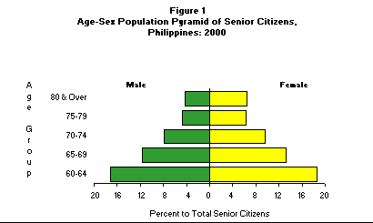
Philippine Demographics
The percentage distribution of senior citizens tails off as age increases
Female senior citizens outnumbered males in all age groups with the biggest gap in the 80 years and over age group.
Source: NSO, 2000 Census of Population & Housing

Slide 8
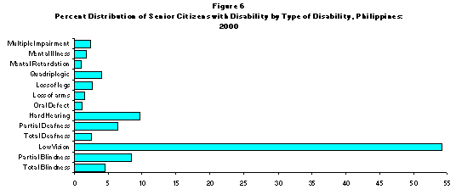
Philippine Demographics
Low vision was the common disability among senior citizens (54.11 percent)
Source: NSO, 2000 Census of Population & Housing

Slide 9
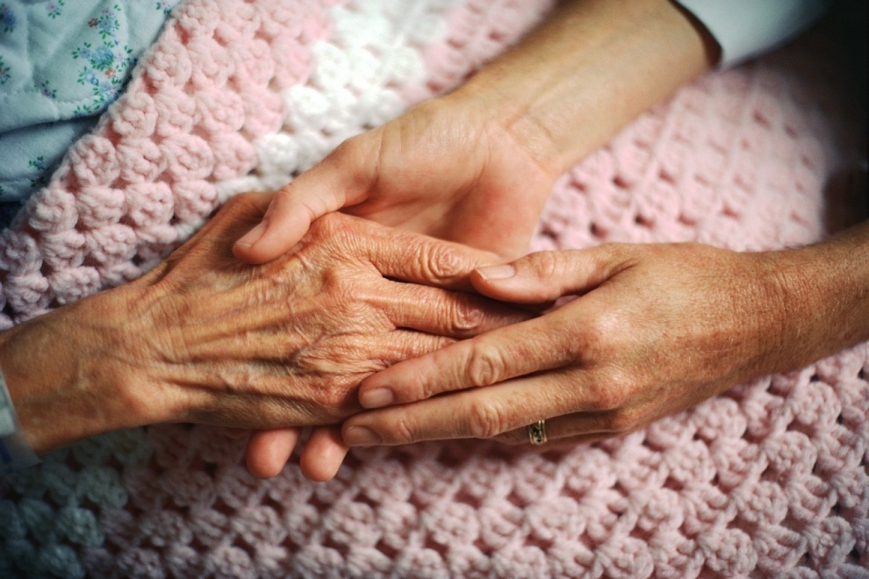
The Problems confronting the Frail Elderly and development of appropriate preventive interventions are a GLOBAL problem.

Slide 10
What is Frailty?

Slide 11
Frailty
Refers to a loss of physiologic reserve that makes a person susceptible to disability from minor stresses.
An inherent vulnerability to challenge from the environment.
Not dependent on age, diagnosis or functional ability

Slide 12
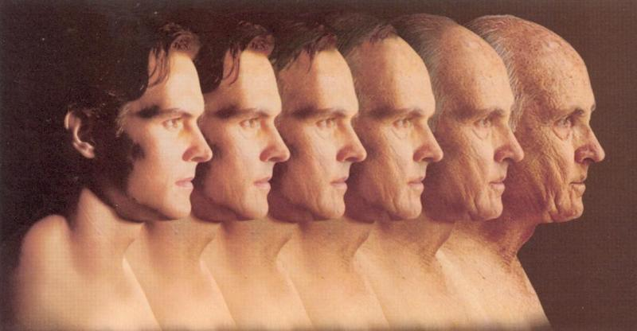
Full forty years between age 60 to 100

Slide 13
Frailty
Functional status varies considerably among older adults
Portion remain independent in daily function
Majority after 85 years need some assistance with instrumental activities
Frail elderly are severely disabled

Slide 14
Frailty (Fried et al.)
Frailty was defined as a clinical syndrome in which 3 or more of the following criteria were present:
Unintentional weight loss (10 lbs in past yr)
Self-reported exhaustion
Weakness (Grip strength)
Slow walking speed
Low physical activity

Slide 15
Common Features of Frailty
Weakness
Weight loss (unexplained)
Muscle wasting (sarcopenia)
Exercise intolerance
Frequent falls
Immobility
Incontinence
Instability of chronic diseases

Slide 16
Associated Features of Frailty (Fried et al [2001], Community-based study)
Older Age
Female
Less Education
Lower Income
Poorer Health (Multiple co-morbid chronic disease)

Slide 17
At point 1:
Risk factors for accelerated chronic loss of physiological capacity e.g. disease
inactivity
At point 2:
Risk factors for acute/subacute loss of physiological capacity e.g. Influenza
Hip Fracture
M.I.
At point 3:
Risk factors for blocked recovery from physiological loss e.g.:
depressive illness
polypharmacy
fear of falling
malnutrition
“misbelief that rest is healthful”
MI
Physiological capacity
Level of physiologic capacity associated with difficulty in recovery
Conceptual model of risk factors for frailty (Buchner and Wagner)
The goal of preventive strategies is to reduce or eliminate the factors that threaten physiologic capacity

Slide 18
Frailty as a Clinical Syndrome
Clinical Syndrome of Frailty
Symptoms
Weakness
Fatigue
Anorexia
Under nutrition
Weight Loss
Signs
Physiologic changes marking increased risk
Decreased muscle mass
Balance and gait abnormalities
Severe deconditioning
Adverse Outcomes of Frailty
Falls
Injuries
Acute Illnesses
Hospitalizations
Disability
Dependency
Institutionalization
Death

Slide 19
The CSHA Clinical Frailty Scale (Canadian Study on Health and Aging)
1 | Very Fit | Robust, active, energetic, well motivated and fit; these people commonly exercise regularly and are in the most fit group for their age
2 | Well | Without active disease, but less fit than people in category
3 | Well, with treated comorbid disease | Disease symptoms are well controlled compared with those in category 4
4 | Apparently vulnerable | Although not frankly dependent, these people commonly complain of being “slowed up” or have disease symptoms
5 | Mildly frail | With limited dependence on others for instrumental activities of daily living
6 | Moderately frail | Help is needed with both instrumental and non-instrumental activities of daily living
7 | Severely frail | Completely dependent on others for the activities of daily living, or terminally ill

Slide 20
The CSHA is based largely on a person’s function for Basic and Instrumental Activities of Daily Living (ADL and IADL)
ADL (Non-instrumental activities of daily living; related to personal care)
Mobility in bed
Transfers
Locomotion inside and outside the home
Dressing upper and lower body
Eating
Toilet use
Personal hygiene
Bathing
IADL (Activities required to live in the community)
Meal preparation
Ordinary housework
Managing finances
Managing medications
Phone use
Shopping
Transportation

Slide 21
Stages of Frailty
Speechly / Tinnetti:
“There may be a transitional state between vigor and frailty.”
“Earlier” stage of frailty – patient should be screened and interventions instituted
“ If lack of full recovery after an illness Then: need for aggressive “Rehabilitation” after acute illness and “Prehabilitation” when surgery is anticipated.

Slide 22
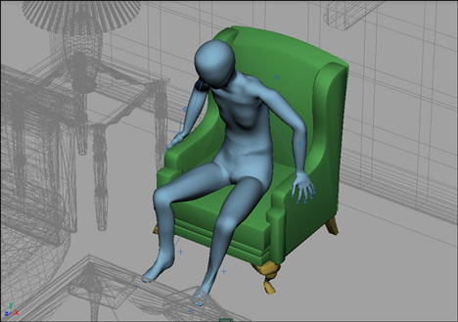
Stages of Frailty
Late stage may not be reversible.
“Failure to Thrive” Syndrome

Slide 23
Stages of Frailty
Characteristics of Hospitalized Individuals with Failure to Thrive
(Berkman B. et al, Gerontologist, 1989)
Mean age 79
Average of 6 diagnoses
Symptoms similar to clinical syndrome of frailty
Malnourished, dehydrated, skin ulcers, falls, pain, cognitive disabilities
Very limited effective intervention
16% die during hospitalization

Slide 24
Potential Causes of Frailty
Decline in function of multiple organ systems (due to aging) = enhance vulnerability to stressors
Hypothalamic – pituitary – adrenal axis (Central regulators of homeostasis)
Older animals show decrease ability to terminate the adrenocortical response to stress ; decrease hippocampal glucocorticoid receptors
Prolonged poststress corticosterone elevation contribute to catabolic state

Slide 25
Potential Causes of Frailty
Decline of growth hormone levels
Contribute to decrease protein synthesis and muscle mass
Decrease bone mass
Diminish immunologic states
_{(NEJM 1990 Rudman et al).}
Clinical Trial: 21 healthy GH deficient men ages 61-81 receive rhGH
Increase lean body mass 9%
Decrease adipose tissue 14%

Slide 26
Potential Causes of Frailty
Changes in immune system may be due to T cell dysfunction
Increase lymphoproliferative disorder
Susceptibility to infection
Autoimmune disorders

Slide 27
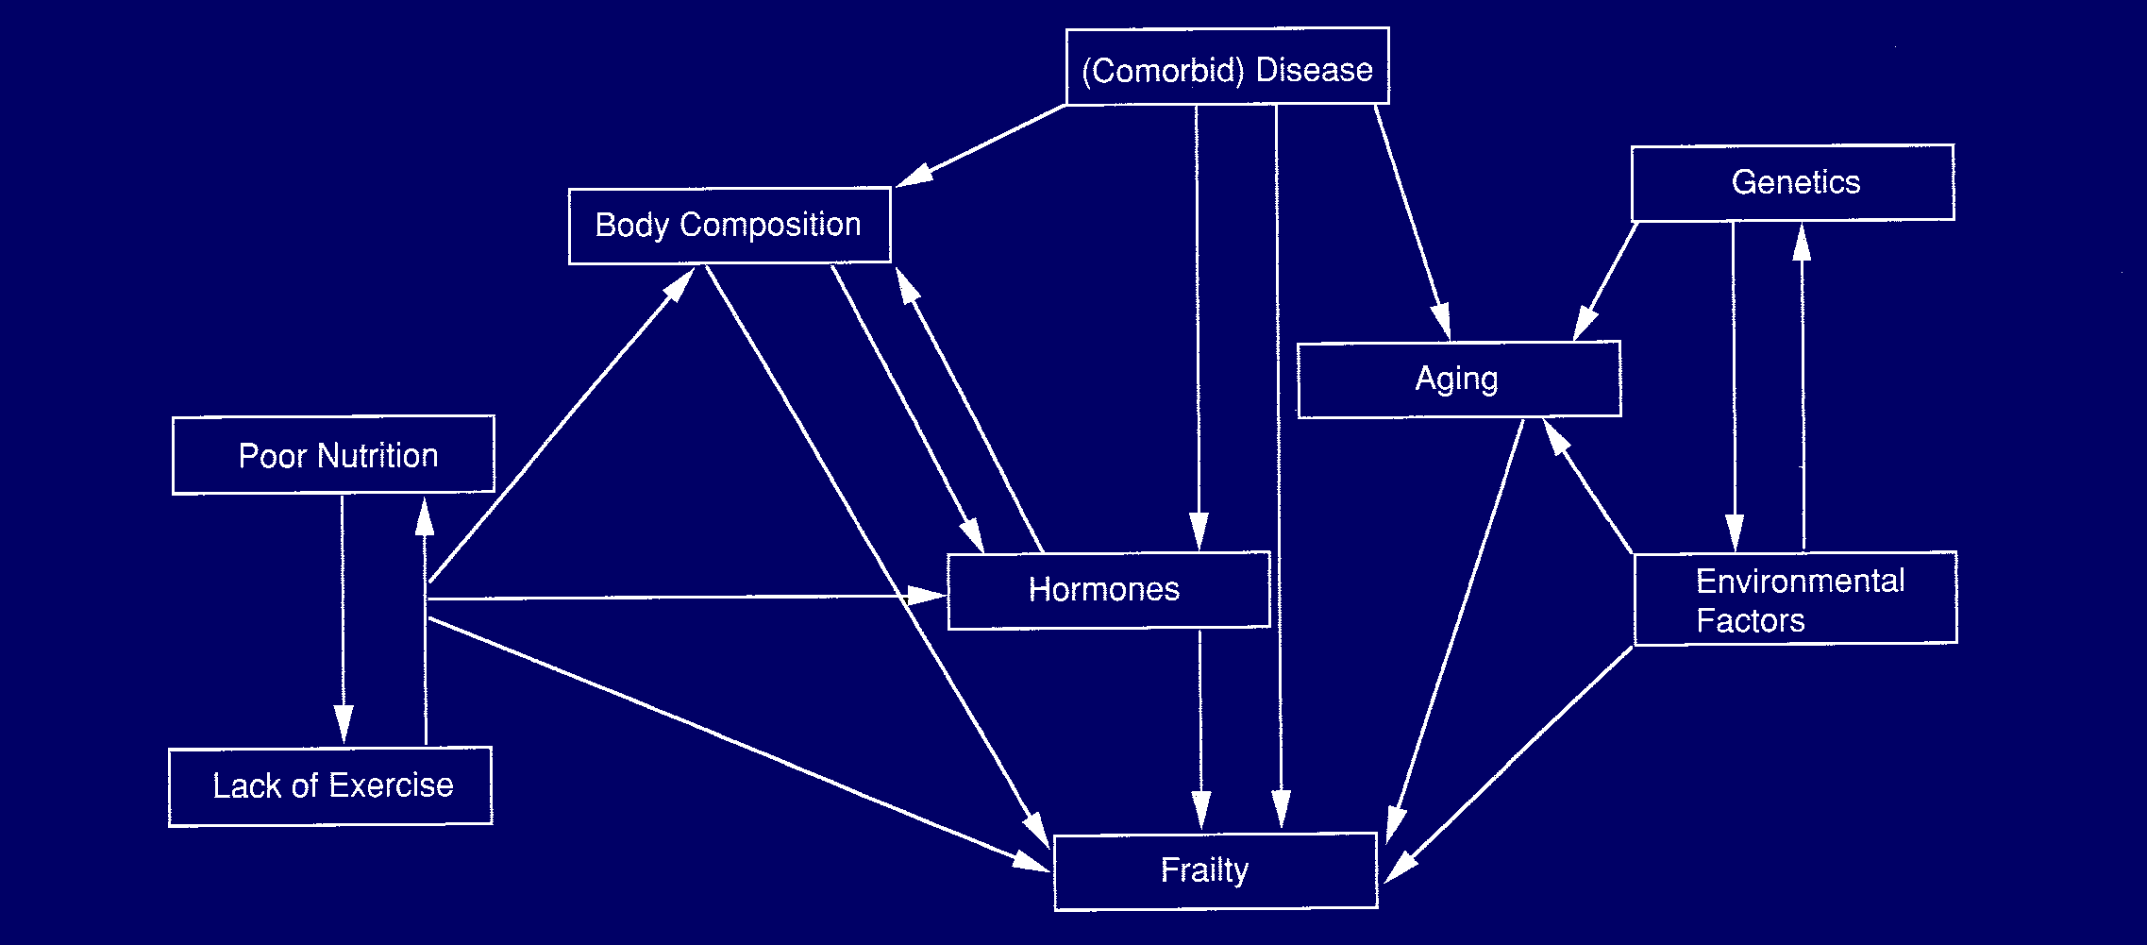
Physiologic Contributors to Frailty (Hazzard et al: Principles of Geriatric Medicine)
Web diagram shows interrelationship of physiologic changes leading to frailty.

Slide 28
Challenges and Solutions in Care of the Frail Elderly
IMPORTANT to recognize the vulnerable and frail before adverse outcomes
Recognize components that are reversible
Recognize the syndrome early
Prevention of adverse outcomes (i.e. falls, medication side effects)
Increase physical activity level of FOA (improved strength, flexibility, exercise tolerance, nutrition)
Prehabilitation and rehabilitation prevent decline associated with prolonged bedrest due to illness or surgery

Slide 29
Challenges and Solutions in Care of the Frail Elderly
Improve Quality of Acute Hospital Care
Intensive case management – hospital-based Advanced Practice Nurses intervene early
Identify newly admitted FOA early, aggressively monitor progress through discharge
Coordinate efforts of health care team
Educate staff, patient and families
Bridge communication and clinical gaps between systems (i.e. hospital ←→ NH )
Facilitate access to programs and services

Slide 30
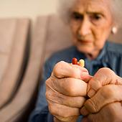
Challenges and Solutions in Care of the Frail Elderly
Be aware “BEWARE” of “cascade” of acute hospital care

Slide 31
Complication of Hospitalization
Hopitalization
Functional Symptom
Medical Intervention
Medical Complication
Restraints
Thrombophlebitis
Pulmonary embolus
Confusion
Drugs
Not Eating
Nasogastric tube
Aspiration pneumonia
Restraints
Thrombophlebitis
Falling
Fracture
Incontinence
Foley catheter
UTI / Septic shock

Slide 32
Challenges and Solutions in Care of the Frail Elderly
Early detection of acute illness
Delivery of medical treatment in least stressful site of care (i.e. home)

Slide 33
Challenges and Solutions in Care of the Frail Elderly
Comprehensive Geriatric Assessment
Allows for evaluation of the frail older patient’s health status and functional impairments in multiple areas or domains. (Diagnosis, medication, nutrition, bowel function, continence, cognition, emotion, mobility)

Slide 34
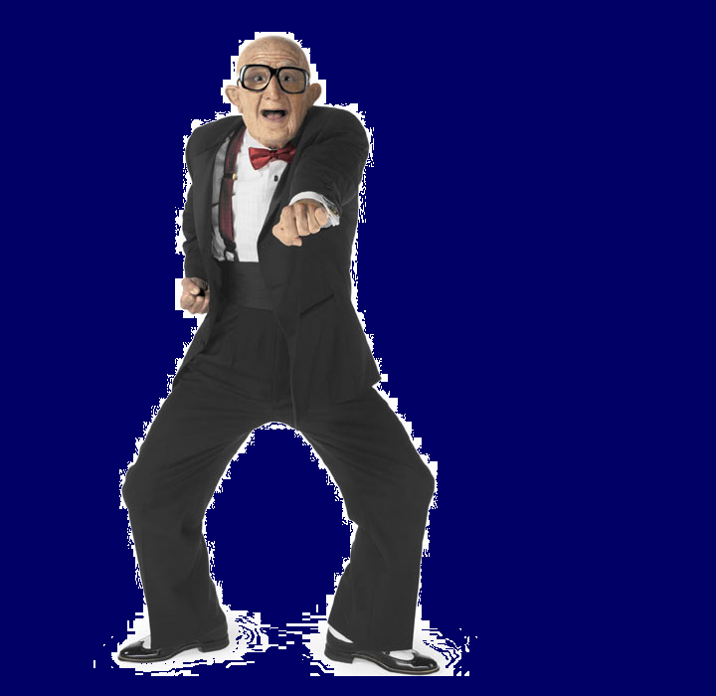
Advantages of CGA
Creation of individual treatment plan with a multidisciplinary team
Improve functional outcome
Improve patient survival
Reduction in hospital days
Reduction in readmission rates
No increase in mortality

Slide 35
Challenges and Solutions in Care of the Frail Elderly
Elderly with irreversible declines in functional capacity, QUALITY hospital care may shift from survival at all cost to improving patient’s functional outcome.
Palliative Care alternatives for respiratory/ cardiac failure, weight loss, pain management.

Slide 36
Advancing Health and Well Being Into Old Age in Filipino Society (Philippine [Inter-Agency] and DSWD Plan of Action CY 2007)
Advocacy on prevention of common diseases
Conduct regular medical check-up of senior citizens in rural health units (RHU).
Conduct care giving trainings to families of sick and frail senior citizens
Conduct seminars on gerontology, physical fitness program, nutrition education and dietary counseling

Slide 37
Advancing Health and Well Being Into Old Age in Filipino Society (Philippine [Inter-Agency] and DSWD Plan of Action CY 2007)
Establish geriatric wards in government and private hospitals.
Implementation of neighborhood support services for older persons (NSSOP).
Ensure the implementation of the Philippine Plan of Action for Nutrition (PPAN) as a blueprint and country’s guide for action to achieve nutritional adequacy for Filipinos

Slide 38
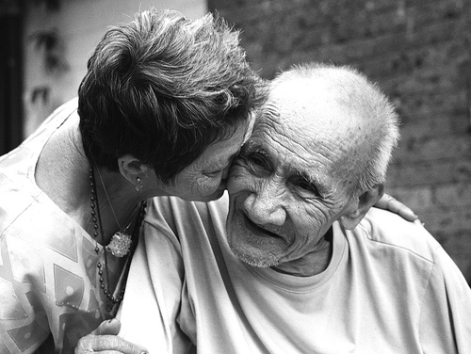
Thank You
Have a good day!

