Slide 1
Morbidity and Mortality Conference: FOOT LOOSE
Ma. Jayme Laurice Macandog-Segarra, M.D.
Michelle B. Moreno-Maliwat, M.D.
3rd year Medical Residents

Slide 2
OBJECTIVES
To present a case of diabetic foot who developed complications after surgery
To discuss the complications and measures to prevent such complications after lower extremity amputation.

Slide 3
THE CASE...
F.T.
67 , male
Admitted October 17, 2009
Chief Complaint:
Non-healing wound in the 3rd & 4th digits of right foot

Slide 4
HISTORY OF PRESENT ILLNESS
3 days PTA
wound over 3rd and 4th digits of R foot with foul-smelling discharge and dark discoloration
(+) pain and swelling
Cleansed with Betadine and hydrogen peroxide
No consult, no medications taken
No fever

Slide 5
HISTORY OF PRESENT ILLNESS
Few hours PTA …
Increasing R foot pain
(+) difficulty in ambulating and numbness over affected area
Consult MMC-ED
Admission

Slide 6
REVIEW OF SYSTEMS
General | (+) anorexia, (-) generalized weakness, (-) fever, (-) fatigue
Skin | (-) rashes, (-) itching
HEENT | (-) BOV, (-) tinnitus, (-) ear discharge, (-) nosebleed, (-) sore throat, (-) hoarseness, (-) stiff neck
Respiratory | (-) hemoptysis, (-) dyspnea
Cardiac | (-) chest pain, (-) palpitations, (-) PND, (-) orthopnea
Gastrointestinal | (-) dysphagia, (-) nausea, (-) vomiting, (-) hematemesis, (-) diarrhea, (-) constipation, (-) melena
Urinary | (-) dysuria, (-) frequency, (+) nocturia, (-) urgency (-) dribbling
Musculoskeletal | (-) myalgia, (-) arthralgia, (-) claudication, (-) neuropathy
Hematologic | (-) easy bruising, (-) bleeding tendencies
Endocrine | (-) excessive sweating, (-) heat or cold intolerance, (+) polyuria

Slide 7
PAST MEDICAL HISTORY
Diabetes mellitus, type 2
Metformin 1000 mg BID
Glyburide 5mg OD
Humulin 70/30 (30-0-25) SC
Hypertensive Atherosclerotic Coronary Artery Disease, s/p CABG 3 vessel disease (1997)
Clopidogrel 75mg OD
Valsartan 160mg OD
Metoprolol 25mg OD
Simvastatin 20mg OD
Notes:
DM since 1997

Slide 8
PAST MEDICAL HISTORY
Other medications:
Furosemide 40mg OD
Spironolactone 25mg OD
No asthma, allergies
No surgeries

Slide 9
FAMILY HISTORY
(+) Hypertension, DM – father
No history of heart attack, asthma, liver/kidney disease
PERSONAL/SOCIAL HISTORY
Previous smoker 30 pack years
Previous alcohol beverage drinker
(5 bottles/week) stopped in 1997

Slide 10
PHYSICAL EXAMINATION
General survey | Conscious, coherent, not in distress
Vital signs | BP 150/80 HR 106 RR 22 T 37.4 Wt 55.4kg Ht 162.5cm BMI 21.1kg/m2
HEENT | Anicteric sclerae, pink conjunctivae, JVP 9-10, no cervical lymphadenopathy, no carotid bruit
Chest / lungs | Symmetrical chest expansion, no retractions, clear breath sounds, no rales/wheeze/rhonchi
Heart | Adynamic precordium, tachycardic, regular rhythm, distinct S1 and S2, no murmurs

Slide 11
PHYSICAL EXAMINATION
Abdomen | Flabby, normoactive bowel sounds, soft, no tenderness, no organomegaly, no masses
Extremities | Hyperpigmented, scaly skin, both LE; (+) open wound on the plantar aspect 3rd web space and base of 4th digit with discharge, right; (+) swelling, right foot; (+) tenderness over dorsum of right foot; absent dorsalis pedis pulse, right; weak dorsalis pedis, left
Notes:
Full ROM, MMT 5/5
Sensory: with deficit 80% R&L foot
Weak pulse: dorsalis pedis, left
Absent pulse: posterior tibial, right
dorsalis pedis, right

Slide 12
SALIENT FEATURES
67 year old, male
Diabetic
HASCAD, s/p CABG
Non healing wound in 3rd & 4th digit, right foot
BP 150/80 HR 106
RR 22 T: 37.4
open wound on the plantar aspect 3rd web space and base of 4th digit with discharge, right
swelling, right foot
tenderness over dorsum of right foot
absent dorsalis pedis pulse, right; weak dorsalis pedis, left

Slide 13
ADMITTING IMPRESSION
Cellulitis, right foot; T/C Diabetic foot vs Peripheral Arterial Occlusive Disease
Diabetes Mellitus type 2, insulin-requiring
Hypertensive Atherosclerotic Coronary Artery Disease, s/p CABG (1997)

Slide 14
Diabetic foot…
Lifetime risk of a person with diabetes developing a foot ulcer is as high as 25%.
Annual incidence of foot ulcers is ~ 2%
Infection is most often a consequence of foot ulceration which typically follows trauma to a neuropathic foot
Classified as ischemic or neuropathic
Spectrum of microbial flora in DM foot ulcers. Indian journal of Pathology and Microbiology, April-June 2008
Comprehensive foot examination and risk assessment: Task Force report. Diabetes Care. August 2008
Notes:
Infected foot ulcer is a common cause of morbidity in diabetic patients, ultimately leading to dreaded complications like gangrene and amputations.

Slide 15
Notes:
Approximately 45% to 60% of all diabetic ulcerations are purely neuropathic, while up to 45% have neuropathic and ischemic components.

Slide 16
At the ER…
Diagnostics
CBC
STAT5, BUN, Crea
X-ray of right foot
ECG
CXR
Urinalysis
HbA1c
Pt/PTT
Hgb | 12 |  | Na | 133
Hct | 36.4 |  | K | 4.3
WBC | 24.97 |  | BUN | 25.99
N | 84 |  | Crea | 1.4
L | 7 |  | RBS | 217.13
M | 7 |  | HbA1c | 10.2%
Plt | 278
PT: 67.7% activity; 1.26 INR
PTT: 36 vs 26.4

Slide 17
At the ER…
Diagnostics
CBC
STAT5, BUN, Crea
X-ray of right foot
ECG
CXR
Urinalysis
HbA1c
PT/PTT
Wound GS/CS
Doppler Ultrasound of both lower extremities
X-ray of R foot
Osteoarthritis, big toe
Minimally calcified metatarsal artery
CXR
Plate-like atelectases vs fibrosis, lower lung fields
Mild cardiomegaly
Sternotomy wires and vascular clips noted

Slide 18
At the ER…
Diagnostics
CBC
STAT5, BUN, Crea
X-ray of right foot
ECG
CXR
Urinalysis
HbA1c
PT/PTT
Wound GS/CS
Doppler ultrasound of both lower extremities
ECG:
sinus tachycardia (111 bpm)
Left atrial enlargement
Lateral wall ischemia
Urinalysis
+1 sugar, +3 protein
7 rbc, 2 wbc, 3 ec, 2 bacteria
0-1 hyaline cast

Slide 19
XRAY OF RIGHT FOOT

Slide 20
CXR (10/17/09)

Slide 21
ECG (10/17/09)
Notes:
ECG: sinus tachycardia, premature atrial contractions, left atrial enlargement, lateral wall myocardial ischemia
Ventricular rate: 111

Slide 22
Wound GS
Many gram positive cocci in pairs
Many gram negative rods

Slide 23
Microbiology
Aerobic gram + cocci – predominant micoroorganisms
S. aureus and B-hemolytic streptococci
Chronic wounds develop a more complex colonizing flora
Enterococci, various Enterobacteriaciae, obligate anaerobes, P. aeruginosa
Diagnosis and treatment of diabetic foot infections. IDSA guidelines 2004
Notes:
Infected foot ulcer is a common cause of morbidity in diabetic patients, ultimately leading to dreaded complications like gangrene and amputations.

Slide 24
Pathogens associated with various foot-infection syndromes

Slide 25
Diabetic foot…
Polymicrobial in nature
Predominantly Gram-negative organisms are isolated – 76%
P. aeruginosa (22%), Klebsiella (17%), E. coli (18%), Proteus (11%)
Gram-positive comprises the 24%, commonly S. aureus (19%)
Fungal isolates, i.e. Candida species may be isolated
Spectrum of microbial flora in DM foot ulcers. Indian journal of Pathology and Microbiology, April-June 2008
Notes:
Infected foot ulcer is a common cause of morbidity in diabetic patients, ultimately leading to dreaded complications like gangrene and amputations.

Slide 26
At the ER…
Tetanus toxoid 0.5 ml IM
Tetanus immunoglobulin 250 units IM
PNSS 1L x 60 ml/hr
Clindamycin 600mg IV q8
Ceftriaxone 1g IV q12
Tramadol 50mg IV q8 prn
Sulodexide 1 tab 2xday
Notes:
CBG pre meals and HS
CBG: 217 (last meal: 0900 bread and butter)
Ketones 0.1

Slide 27
At the ER…
ORTHO referral
wet gangrene 3rd digit Right foot with cellulitis
suggest AKA right leg
Tramadol 50 mg IV q4 RTC
Pethidine 50 mg IM q6 prn
Keep R foot elevated

Slide 28
Doppler ultrasound of veins & arteries of both lower extremities (10/17/09)
No blood flow starting from the mid segment of the right posterior tibial artery, proximal segments of the bilateral anterior tibial arteries, and proximal segment of the left posterior tibial artery.
Venous insufficiency in the right greater saphenous vein, right deep femoral vein and left common femoral vein
No evidence of venous thrombosis in the lower extremities

Slide 29
At the ER…
CARDIO referral for clearance
Dobutamine MPI
Resume following meds
Valsartan 160mg OD
Spironolactone 25 mg OD
Metoprolol 50mg ½ tab OD
Simvastatin 20mg 1 tab at bedtime
Furosemide 40mg OD

Slide 30
Dobutamine MPI
Normal dobutamine myocardial perfusion imaging.
There was no evidence for significant dobutamine-induced myocardial ischemia.
Mild left ventricular cavity dilation.

Slide 31
Epidemiology of Diabetic Foot
Approximately 40-60% of all non-traumatic lower extremity amputations are performed on patients with diabetes
85% of diabetes-related lower extremity amputation are preceded by a foot ulcer
The prevalence of foot ulcer is 4 – 10% of the diabetic population

Slide 32
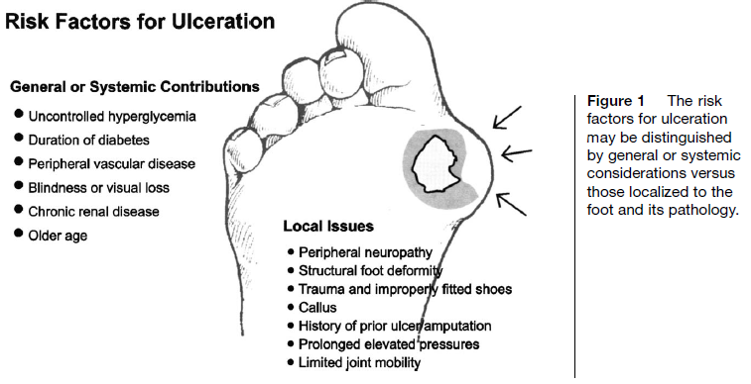
Pathophysiology
Notes:
Foot ulceration is the most common single precursor to lower extremity amputations among persons with diabetes.
Risk factors identified include peripheral neuropathy, vascular disease, limited joint mobility, foot deformities, abnormal foot pressures, minor trauma, a history of ulceration or amputation, and impaired visual acuity. These and other putative causative factors are shown in Figure 1.
Peripheral sensory neuropathy in the face of unperceived trauma is the primary factor leading to diabetic foot ulcerations

Slide 33
1st Hospital day
Ortho
Still with pain on right foot, no dorsalis pedis, R; 30% sensory deficit
Tramadol drip was started
Suggest AKA ASAP
Cardio
Metoprolol shifted to Bisoprolol
Enoxaparine 40mg SC OD
Endo
Antibiotics shifted to Piperacillin -Tazobactam 2.25 IV q8
Episodes of hypoglycemia
Notes:
.

Slide 35
Limb-Threatening infections
Early surgical treatment of the affected site is typically necessary as an integral part of infection management
Hospitalization is required to treat the infection as well as systemic sequelae
Patients with poor vascular status and ischemia have an increased potential for amputation and require prompt consultation for potential revascularization
Notes:
Foot infections may be described in terms of severity, extent of involvement, clinical appearance, location, and etiology.
One well accepted method simply provides two categories: non-limb-threatening and limb-threatening infections. This scheme implies severity of infection and, accordingly, directs subsequent management while also portending a general prognosis for outcome.
Clinically, non-limb-threatening infections are usually seen with ulceration that is superficial, without significant ischemia, and a wound that does not probe to bone or joint. Ulceration, however, does not need to be present, since non-limb-threatening infections can result from small puncture wounds, scratches, or simple fissures. Cellulitis in this category of infections is 2 cm or less from the ulceration or portal of entry. Patients with non-limb-threatening infections are medically stable and usually do not present with signs and symptoms of systemic involvement. This relatively mild to moderate infection can be managed on an outpatient basis, with close supervision from the clinician
Limb-threatening diabetic foot infections have cellulitis that extends beyond 2 cm (430). Additional clinical features may include fever, edema, lymphangitis, hyperglycemia, leukocytosis, and ischemia; however, the diabetic patient with a relatively severe infection may not necessarily present with these signs and symptoms (178). If an ulcer is present it may probe to bone or joint, which is highly predictive of osteomyelitis . Therefore, it is important to review the patient’s entire clinical assessment (see Table 3) to guide the clinician to the proper course of treatment. Gangrene, abscesses, osteomyelitis, and necrotizing fasciitis may also be present. Hospitalization is required to treat the infection as well as systemic sequelae. Patients with poor vascular status and ischemia have an increased potential for amputation and require prompt consultation for potential revascularization. When such an infection is recognized, the patient requires
emergent hospital admission for appropriate intervention
* Early surgical treatment of the affected site is typically necessary as an integral part of infection management. This may include simple debridement of the soft tissues, wide incision and drainage of the pedal compartments, or open amputation to eliminate extensive areas of infection. At the time of debridement, aerobic, anaerobic, and fungal tissue cultures should be obtained from the depth of the wound to provide reliability.
* Even the sickest of patients should be considered for emergent incision, drainage, and debridement procedures, because their illness in this regard is directly attributable to the infection severity.

Slide 36
2nd Hospital day
Had febrile episode, Tmax 38.5
ID referral
Blood cultures x 2
Relatives undecided yet to proceed with the amputation
Pip Tazo 4.5g IV q12
Vancomycin 1 g IV x 1 dose
Notes:
Plan to fly to US by thursday

Slide 37
3rd Hospital day
Still had febrile episodes, Tmax 38.3
BP 110-140/ 70-100 HR 90-118 RR 20-24
CBC, CXR
Hyperbaric O2
Bisoprolol increased to 5mg OD
Ivabradine 5 mg 2 x day
Vancomycin 1g IV q12
Notes:
Hyperbaric O2 therapy was contemplated while waiting for consent for surgery.
Considering the present status of the pt, beginning sepsis due to non healing wound, right, pt was cleared CV wise for AKA.
Patient’s relatives decided to proceed with surgery

Slide 38
CBC | 10/17/09 | 10/20/09
Hgb | 12.0 | 10.5
Hct | 36.4 | 37.9
WBC | 24.97 | 25.66
Segmenters | 84 | 86
Lymphocytes | 7 | 5
Monocytes | 7 | 6
Eosinophils | 1
Platelet | 278 | 313

Slide 39
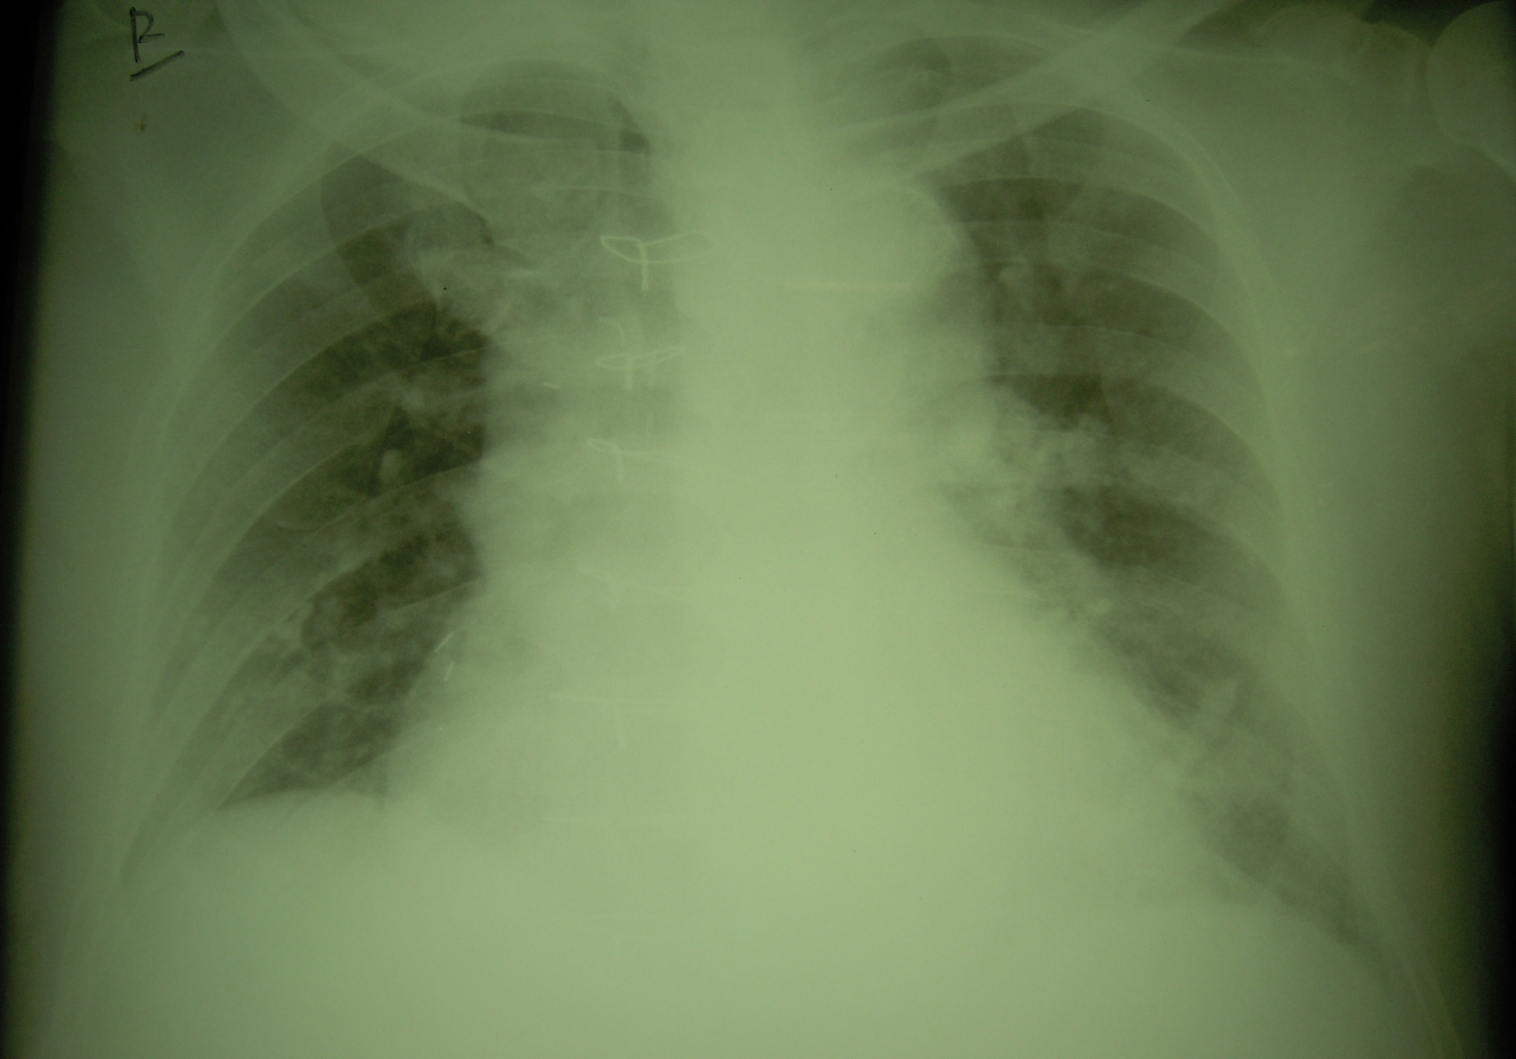
Notes:
10/20/09
Follow up examination shows clearing of the plate-like opacity in the right base. There is persistence of the opacity in the left lung base. Mild cardiomegaly is again noted.

Slide 40
Role of Hyperbaric O2 Therapy
It promotes healing in diabetic foot by its anti-edema, antibacterial and neovascularization effects
Can be used as an adjunct to standard wound care in the treatment of diabetic foot ulcers.
Abidia, et.al. The role of HBOT in Ischemic Diabetic Lower Extremity Ulcer: Eur J Vas Endovasc Surg 2003.
Notes:
Hyperbaric oxygen therapy (HBOT) is a treatment option for diabetic patients with a foot ulcer, where the patient inhales 100% oxygen in a pressurized chamber
1- HBOT because of its oxygen gradient promotes formation of new blood vessels required for wound healing, and increases fibroblast proliferation and collagen formation
2- has bactericidal and bacteriostatic effects on both aerobic and anaerobic bacteria through the action of superoxide enzyme
3- hyperoxic vasoconstriction reduces capillary pressure and increases vascular permeability. The resulting decrease in transcapillary fluid transfer increases extravascular fluid resorption, which reduces lower extremity edema
2- this enhances neutrophil killing ability, stimulates angiogenesis, and enhances fibroblasts activity and collagen synthesis

Slide 41
Role of Hyperbaric O2 Therapy
Amputation was prevented in from 82-95% of patients
Mean limb salvage rate of 89% compared with 61% of patients receiving standard therapy alone
Using HBOT to Treat Diabetic Foot Ulcers. C, Heyneman. Critical Care Nurse. 2002

Slide 42
3rd Hospital day
BP 120/80
HR 120’s
RR 21
T 38.3
JVP 12
Crackles both lung fields
Decrease PNSS to 40 ml/hr
Furosemide 20 mg IV
Notes:
In the afternoon

Slide 43
3rd Hospital day
NEPHRO referral
CKD sec to DM nephropathy
T/C Acute renal failure secondary to sepsis secondary to DM foot
ABGs (room air)
pO2 67.4
pH 7.47
pCO2 30.5
HCO3 22.1
O2sat 94.8
TCO2 23
O2 at 2 lpm
Foley cathether insertion
Central line insertion, right
Kabiven 1400 kcal x 22 hours
Notes:
Initial UO after foley: 550ml
Endo: Kabiven 1400 kcal x 22hrs
Central line for accurate monitoring of fluids. Initial CVP 14
CXR post central line: Pulmonary congestion
CVP line is in place.

Slide 44
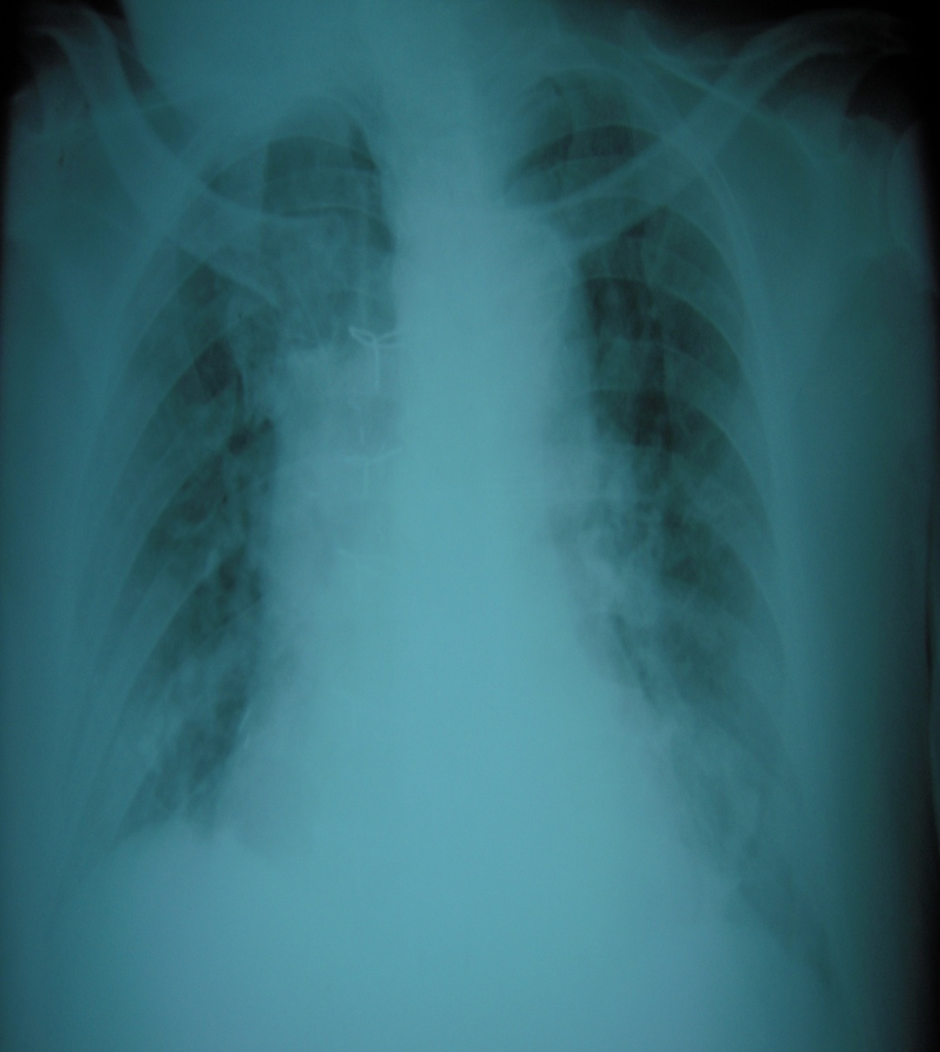
Notes:
10/20/09 AM
Follow up examination shows clearing of the plate-like opacity in the right base. There is persistence of the opacity in the left lung base. Mild cardiomegaly is again noted.
10/20/09 PM post central line insertion
Follow up examination taken at 19:11H shows evidence of pulmonary congestion. CVP line is in place

Slide 45
4th Hospital day
D1 afebrile, D3 Pip-tazo, D2 Vancomycin
PT 66.1% act, 1.28 INR
Transfuse 4 u FFP
Hold Enoxaparin
S/P Above the knee amputation, right
Kabiven was consumed, start Vamin glucose
Notes:
15:20 kabiven to consume. Start vamin
4th HD – 7th HD was unremarkable. Continue Piptazo and vanco. No fever. On 6th HD, central line shifted to peripheral line. Rehab referral.

Slide 46
Wound CS
Moderate growth of Group A Beta-hemolytic Streptococcus and light growth of Group D Streptococci (enterococci) sensitive to Ampicillin and Penicillin

Slide 47
Diabetes and Amputation
DM increases the risk of LEA by 10-20x and is associated with ½ of the LEAs worldwide. ( Fremantle Diabetes Study, 2006)
Adjusted incidences of LEA in patient with DM is 248 per 100,000 person-years and for non-diabetic is 20 per 100,000 person-years
Schofield, MD, et.al. Mortality and Hospitalization in Patients After Amputation. Diabetes Care. 0ctober 2006
Notes:
Foot problems, including amputation account for more hospital admissions for patients with diabetes than any other long-term complications. Many of the affected patients have peripheral vascular dse and/or peripheral neuropathy; also they have co-existing risk factors for both micro- and macrovascular disease.
In a study done by Schofield, they concluded that after LEA,...Median time

Slide 48
Amputation in Diabetic Patients
LEA in diabetics are more common than in non-diabetics with 5 of 6 amputations occur in diabetes
Precipitating factors
Minor trauma (65%)
Burns (10%)
Infection (15%)
Callosities (10%)
Amputation in Diabetic Patients. Singh, MJAFI 2006; 62:36-39
Notes:
Among diabetics presenting with foot lesions, 40% require amputations. 50-70% of all nontraumatic amputations occur in diabetics

Slide 49
Amputation in Diabetic Patients
Risk factors
Duration of diabetes
Poor compliance (FBG>200mg/dL)
Insulin therapy
Absent pedal pulses / ischemic DF
Retinopathy
Nephropathy (proteinuria)
Irregular foot wear habit/walking barefoot
Amputation in Diabetic Patients. Singh, MJAFI 2006; 62:36-39
Independent RF for amputation in DM foot. Abolfazl, et.al. Int J Diab Dev Ctries, April 2008
Notes:
The incidence of LEA in a diabetic patient can be predicted by assessing various risk factors
Patients with 1st-ever incident LEA had longer DM duration, worse glycemic control, and more likely to be insulin-treated, have higher SBP and taking anti-hypertensives. Also significantly likely to have nephropathy, retinopathy, PAD, CVD)
Presence of peripheral vascular diseases causes problems in blood flow; adequate blood flow is essential for healing and combating the severe infections that attack DM foot
Risk of amputation increases in a linear fashion with increases in plasma glucose level
Presence of foot ulcers increases the risk of 1st-ever LEA

Slide 50
5th-7th Hospital Day
S> No recurrence of fever, fair appetite, tolerating diet
O> BP 120-160/80-90 HR 70-92 T afebrile
clean and dry stump, right with no discharge
A> Diabetic foot, S/P AKA, right
P> Vancomycin and Pip-Tazo continued
Enoxaparin 40mg SC OD
Referral to Rehabilitation medicine
Central line shifted to peripheral line
Notes:
On the 5th hospital day, 1st post-op day; Clexane was resumed. CBC showed anemia, 2units packed RBC was transfused.
On the 6th hospital day, 2nd post-op day, patient was referred for physical therapy, central line shifted to peripheral line, Foley catheter was removed, Vamin glucose was consumed. creatinine stable at 1.4-1.5, Nephrology service signed out of case.
On the 7th hospital day, 3rd post-op day, started bedside physical therapy, able to sit up in bed.

Slide 51
5th – 7th Hospital Day
 | 10/22 | 10/24
Hgb | 9.4 | 13.8
Hct | 29.2 | 41.7
WBC | 12.76 | 14.27
N | 78 | 81
L | 12 | 12
E | 2
M | 8 | 7
Plt | 270 | 338
 | 10/22 | 10/24
Sodium | 133 | 132
Potassium | 3.8 | 3.3
Creatinine | 1.5 | 1.5
Notes:
On the 6th hospital day, 2nd post-op day, patient was referred for physical therapy, central line shifted to peripheral line, Foley catheter was removed, Vamin glucose was consumed. creatinine stable at 1.4-1.5, Nephrology service signed out of case.
On the 7th hospital day, 3rd post-op day, started bedside physical therapy, able to sit up in bed.

Slide 52
Venous Thromboembolism
Almost all hospitalized patients have one or more risk factors for VTE
Hospital acquired DVT and PE are usually clinically silent
It is difficult to predict which at-risk patients will develop symptomatic thromboembolic complications
Antithrombotic and Thrombolytic Therapy 8th Ed: ACCP Guidelines 2008
Notes:
Almost all hospitalized patients have at least one risk factor for VTE, and approximately 40% have three or more risk factors

Slide 53
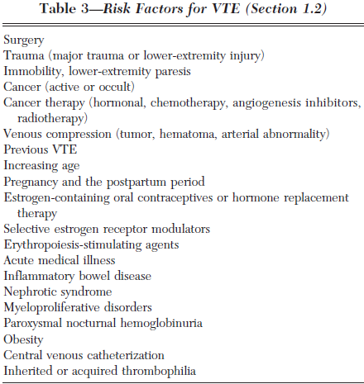

Slide 54
Postoperative VTE was the second-most-common medical complication, the second-most-common cause of excess length of stay, and the third-most common cause of excess mortality and excess charges
Antithrombotic and Thrombolytic Therapy 8th Ed: ACCP Guidelines

Slide 55
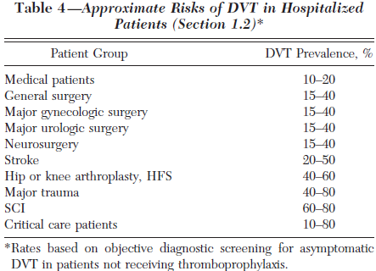
Notes:
Without thromboprophylaxis, hospital-acquired DVT is approx 10-40% among medical or general surgical patients, and 40-60% following major orthopedic surgery

Slide 57
For patients undergoing major general surgery, recommend thromboprophylaxis with a low-molecular weight heparin (LMWH), low-dose unfractionated heparin (LDUH), or fondaparinux (each Grade 1A)
Both LDUH and LMWH reduce the risk of asymptomatic DVT and symptomatic VTE by at least 60% in general surgery compared with no thromboprophylaxis
Antithrombotic and Thrombolytic Therapy 8th Ed: ACCP Guidelines
Notes:
The options that have clearly been shown to reduce DVT and PE are LDUH and LMWH. The clinical advantages of LMWH over LDUH include its once-daily administration and the lower risk of heparin-induced Thrombocytopenia.
Most symptomatic VTE occurs after hospital discharge, and the risk continues to be higher than expected for at least 2 months after surgery.
For patients undergoing major general surgical procedures, we recommend that thromboprophylaxis continue until discharge from hospital (Grade 1A). For selected high-risk general surgery patients, including some of those who have undergone major cancer surgery or have previously had VTE, we suggest that continuing thromboprophylaxis after hospital discharge with LMWH for up to 28 days be considered (Grade 2A).
We recommend that patients undergoing hip or knee arthroplasty or HFS receive thromboprophylaxis for a minimum of 10 days (Grade 1A); for hip arthroplasty and HFS, we recommend continuing thromboprophylaxis > 10 days and up to 35 days.
For each of the antithrombotic agents, we recommend that clinicians follow the manufacturer- suggested dosing guidelines (Grade 1C).

Slide 58
Enoxaparin
In patients with a high risk of thrombo-embolism (e.g. patients undergoing orthopedic surgery), the dosage should be 40 mg administered once daily by subcutaneous injection
In orthopaedic surgery, the first injection is to be given 12 hours pre-operatively
Notes:
For each of the antithrombotic agents, we recommend that clinicians follow the manufacturer- suggested dosing guidelines (Grade 1C).
Enoxaparin treatment is usually prescribed for an average period of 7 to 10 days.
Longer treatment duration may be appropriate in some patients and the treatment should be continued for as long as there is a risk of venous thrombo-embolism and until the patient is ambulatory

Slide 59
8th Hospital day, 4th Post-op day
Stable vital signs
Vancomycin was discontinued and plan to shift to oral antibiotics in AM

Slide 60
8th Hospital day, 1340H
S> Unresponsive, cyanotic
O> BP palpatory 70,
HR 30’s on monitor then asystole
crackles, bilateral
A> CP arrest secondary to Aspiration R/O ACS
P> Intubated, CPR
CBG 100
ABGs
ECG
Cardiac enzymes
Dopamine drip
PNSS 60 ml/hr
ICU transfer
Neurology referral
Notes:
However, at around 1340H, patient was referred because of unresponsiveness and cyanosis. BP noted to be palpatory 70, HR 30’s on cardaic monitor then went to asystole
Px was intubated and CPR done for 12 minutes. A total of 2 atropine 0.5 mg IV; and 5 epinephrine 1mg IV were given. 300 ml of PNSS was also fast-dripped.
Post-arrest, BP was noted to be 90/40, hr 80s, hence Dopamine drip was started at 3 mcg/kg/min
NGT and foley catheter were inserted.
Initial MV settings was: Vt 400, FiO2 100, RR 20, AC mode.

Slide 61
pO2 | 194.1
pH | 7.53
pCO2 | 27.7
HCO3 | 23
O2sat | 99.5
BE | +1.7
TCO2 | 23.9
On AC mode, FiO2 100%
Notes:
ABGs 30 minutes post-intubation showed respiratory alkalosis with adequate oxygenation. FiO2 was decreased to 80
CXR post-intubation: progression of pulmonary congestion, tip of ET tube was in the right mainstem bronchus. ET was adjusted accordingly
Transfer to ICU

Slide 62
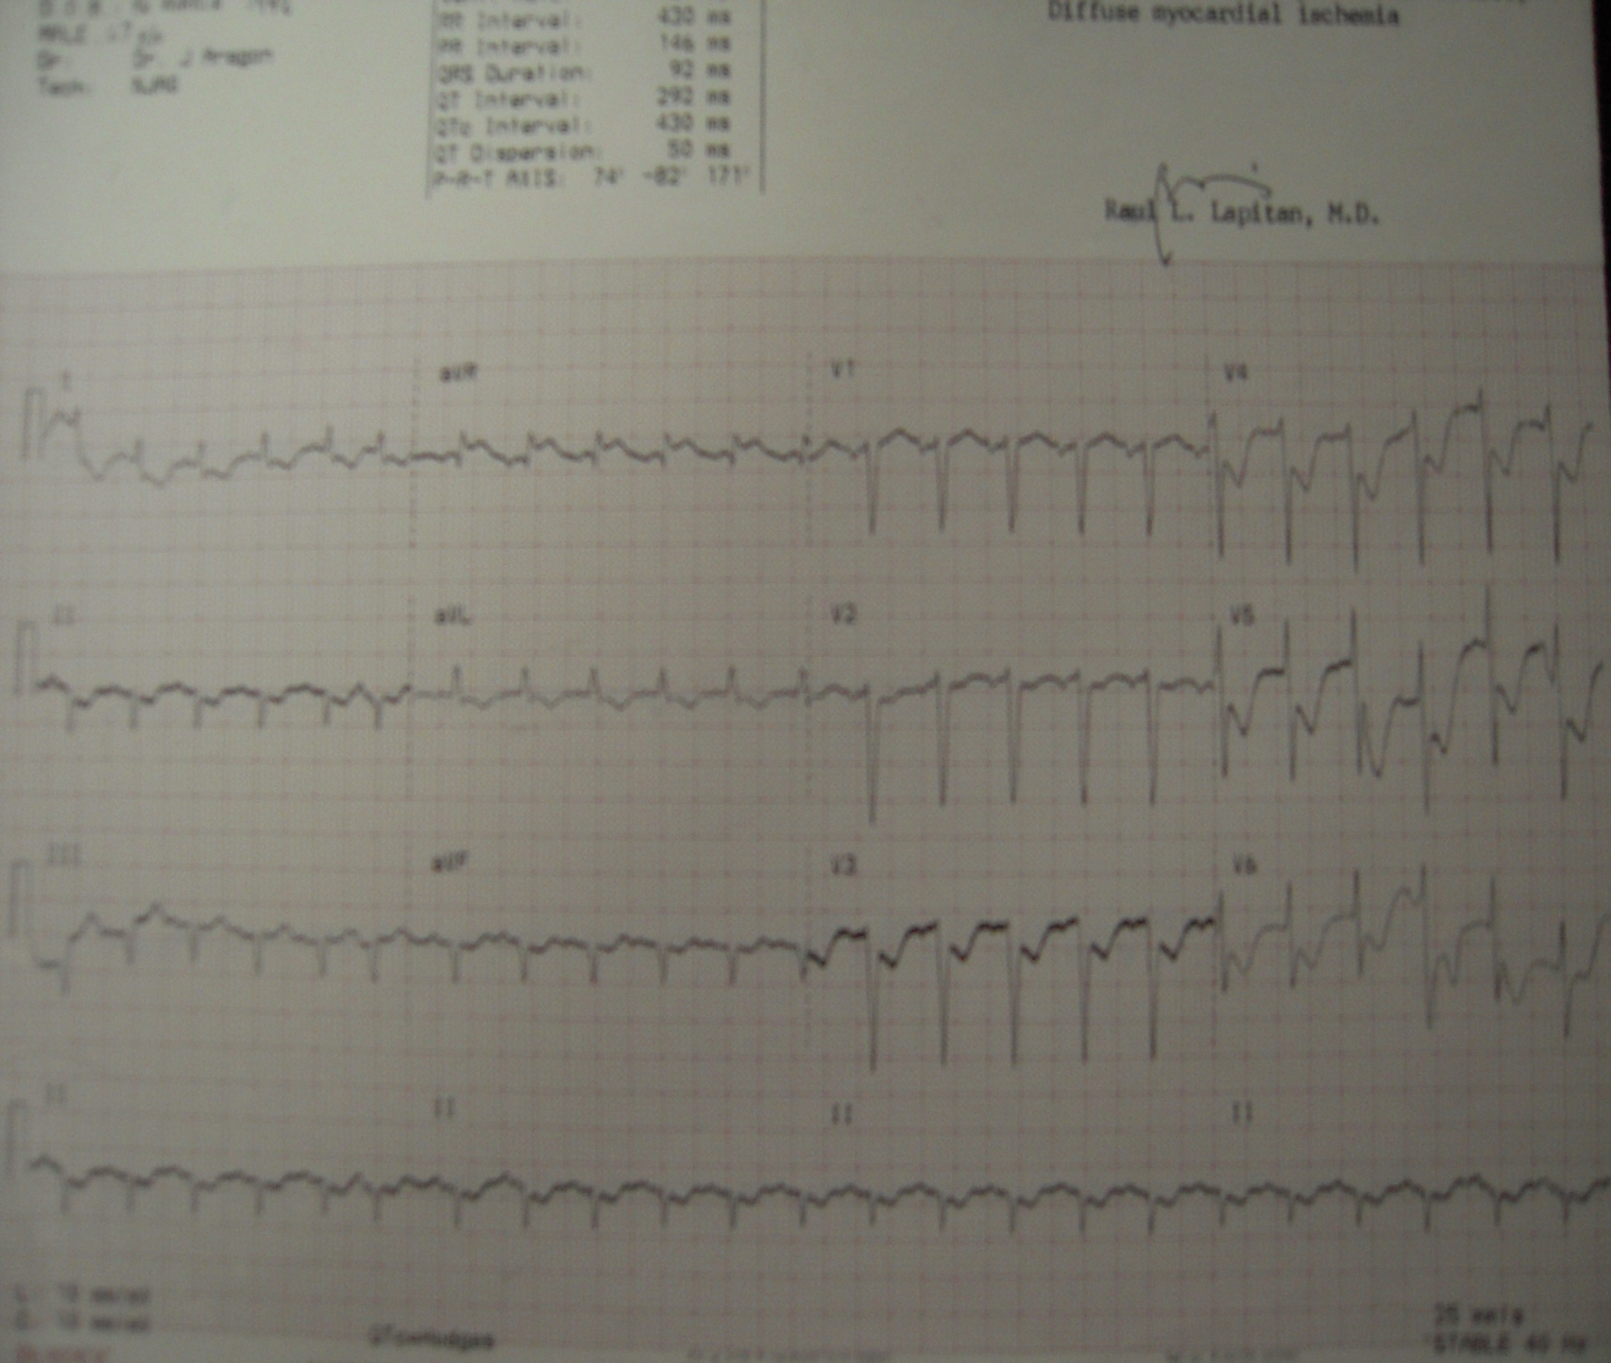
 | 4 pm | 6 pm
Trop I | 0.11 | 0.89
CKMB | 0.80 | 2.5
TCPK | 200 | 287
Sodium | 137
Potassium | 3.3
Creatinine | 1.9
Magnesium | 1.9
Notes:
ECG showed sinus tachycardia (139), left axis deviation, old inferior wall myocardial infarction, diffuse myocardial ischemia

Slide 63
8th Hospital day, 1530H
S> Comatose,
O> pupils 4mm SRTL
(+) ROR, (+) limited dolls
(-) withdrawal to pain on all extremities
A> Hypoxic encephalopathy secondary to prolonged ischemic anoxic arrest
P> Lamictal, Citicoline
Sodium valproate drip, Diazepam
EEG
Notes:
At around 2300H, noted to have upward rolling of eyeballs with myoclonic jerks of both upper extremities, which persisted until around 0100H, hence valproate drip and diazepam were given

Slide 64
8th Hospital day, 2200H
increase creatinine, electrolyte imbalance
Referred back to Nephrology service
KCl solution
Maalox 1 tbsp 3 x day
Furosemide 40 mg IV x 2 doses
Urine output: 40 ml-150 ml
Notes:
At around 2030H, px was referred back to Nephrology service.
PLAN of nephro: monitor fluids I&O and electrolytes for now, if no urine output in 24 hrs, plan to do CRRT or slow hemofiltrate dialysis.
Furo 40mg IV 2x. Nephro: if crea still increasing and UO dec, will do renal replacement therapy.
1:00 Urine output 150ml

Slide 65
9th Hospital day, 0000H
Frequent multifocal PVCs
Non sustained Vtach 30-45 mins
ECG in AM
2 D echo with CFD in AM
Notes:
Px had frequent multifocal PVCs and non-sustained V-tach for 30-45 minutes. Amiodarone 150mg IV, 300mg in 100 x 1 hr, 900/250 x 24hrs. About to defib, but converted to sinus. For 2 d echo with CFD in am.

Slide 66
9th Hospital day, 0315H
refuse dialysis, blood test, other procedure
continue meds, feeding, mechanical ventilator
DNR signed
0545 H: patient expired
Notes:
1:20 ABGs dec Fio2 to 50, add peep of 5, dec Vt 380
3:15 relatives signed DNR, refusing planned dialysis, further blood test and other procedures

Slide 67
Major LE Amputation
Overall 30-day mortality was 8.6%, worse for AKA (16.5%) than BKA (5.7%) patients
Overall survival was 69.7% and 34.7% at 1 and 5 years, respectively. Survival was significantly worse for AKAs (50.6% and 22.5%) than BKAs (74.5% and 37.8%)
Major Lower Extremity Amputation. Aulivola et. al. Arch Surg. 2004

Slide 68
Survival in patients with diabetes mellitus (DM) was 69.4% and 30.9% vs 70.8% and 51.0% in patients without DM at 1 and 5 years, respectively
Survival in end-stage renal disease patients was 51.9% and 14.4% vs 75.4% and 42.2% in patients without renal failure at 1 and 5 years, respectively
Major Lower Extremity Amputation. Aulivola et. al. Arch Surg. 2004

Slide 69
Survival after LEA
 | After AKA | After BKA | Minor amputations
3-mo | 51% | 68% | 92%
6-mo | 49% | 64% | 86%
1-yr | 34% | 60% | 81%
5-yr | 10% | 28% | 59%
Principal cause of death
Sepsis
Heart disease
Stroke
Pneumonia
Renal problems
All-cause Mortality after DM-related Amputation in Barbados. Diabetes Care 2009
Notes:
Low survival rate after a major amputation

Slide 70
Perioperative and Long-term Morbidity and Mortality after LEA
The perioperative cardiac event rate (cardiac death or nonfatal myocardial infarction) was at least 6.8% after AKA and at most 3.6% after BKA
Median survival was significantly less after AKA (20 mo) than BKA (52 mo)
Perioperative and Long-Term Morbidity and Mortality After Above-Knee and Below-Knee Amputations in Diabetics and Nondiabetics. Subramaniam et. al. Anesth Analg 2005;100:1241–7

Slide 71
DM was not a significant predictor of perioperative cardiac events or death or postoperative 3-year survival but was a significant predictor of longer-term (10-year) survival after major amputations
Significant predictors of the 30-day perioperative mortality were the site of amputation and history of renal insufficiency
Perioperative and Long-Term Morbidity and Mortality After Above-Knee and Below-Knee Amputations in Diabetics &Nondiabetics. Subramaniam et. al. Anesth Analg 2005;100:1241–7
Notes:
DM was not a significant predictor of perioperative 30-day mortality (odds ratio, 0.76 [0.39 –1.49]; P 0.43) or 3-yr survival
(Hazard ratio, 1.03 [0.86 –1.24]; P 0.72) but predicted 10-yr mortality

Slide 72
Notes:
3-yr survival was significantly different between diabetic and nondiabetic amputess. Significant predicotrs were age>64, history of CHF, requirement for hemodialysis, and site of amputation
Long-term survival was significantly different

Slide 73
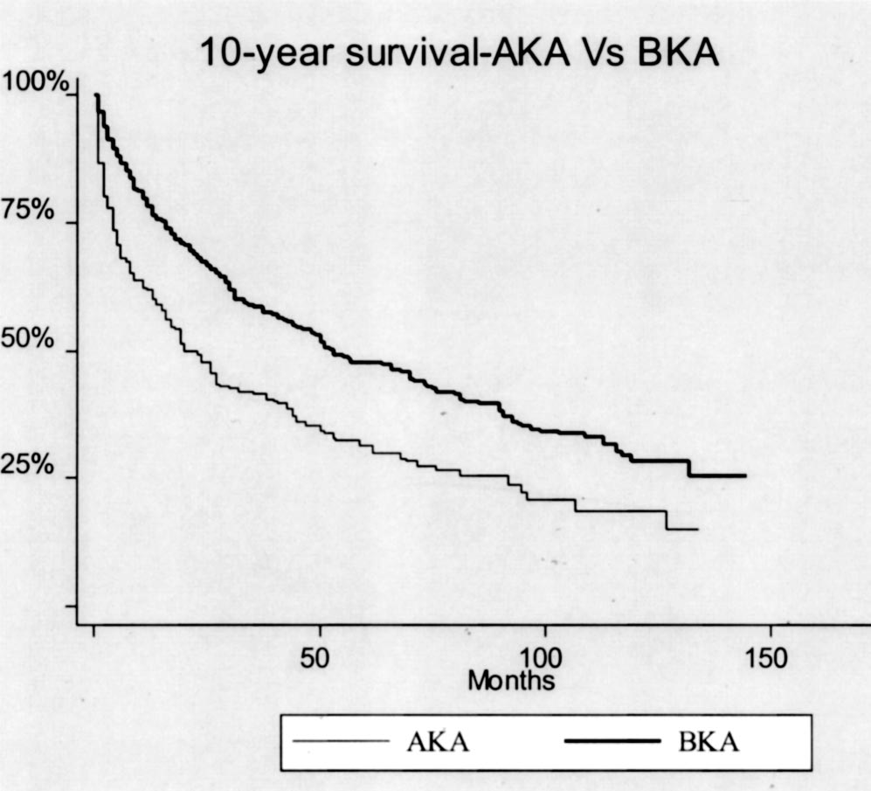
Notes:
Site of amputation affected also the long-term survival .
Long-term survival was 62.1% at 1 yr, 47.7% at 2 yr, 31.5% at 5 yr, and 19.0% at 10 yr for AKA patients
78.2% at 1 yr, 67.1% at 2 yr, 47.9% at 5 yr, and 28.5% at 10 yr for BKA patients

Slide 74
FINAL DIAGNOSIS
CP arrest secondary to Multiorgan Failure
secondary to NSTEMI vs Aspiration Pneumonia
DM foot, right; S/P Above the knee amputation
DM type 2
Hypoxic Encephalopathy secondary to prolonged Ischemic-Anoxic arrest
CKD secondary to DM nephropathy vs HTN nephrosclerosis
HASCAD, s/p CABG

Slide 75
In summary …
Importance of identifying risk factors to detect it at an early stage
Because diabetes is a multi-organ systemic disease, all comorbidities that affect wound healing must be assessed and managed by a multidisciplinary team for optimal outcomes in the diabetic foot ulcer
Notes:
Ulceration, infection, gangrene, and lower extremity
amputation are complications often encountered in patients
with diabetes mellitus. These complications frequently
result in extensive morbidity, repeated hospitalizations, and
mortality.
Not all diabetic foot complications can be prevented, but
it is possible to dramatically reduce their incidence through
appropriate management and prevention programs

Slide 76
In summary …
Educate patient about…
Optimizing glycemic control
Using appropriate footwear at all times
Avoiding foot trauma
Performing daily self-examination of feet
Notes:
Not all diabetic foot complications can be prevented, but
it is possible to dramatically reduce their incidence through
appropriate management and prevention programs

Slide 77
THANK YOU
“Care for your feet as your face or you will bury your
feet before your face”

