Slide 1
Medical Grandrounds
More than you think it is...
Presenter: Ferdinand G. Alcala MD
Moderator: Ma. Tarcela S. Gler MD

Slide 2
OBJECTIVES
To present a course of disseminated cryptococcosis in an immunocompromised patient
To discuss the updated guidelines on the treatment strategies of cryptococcal meningitis in an HIV/AIDS patient
To present an overview of the epidemiology of HIV/AIDS in the country.

Slide 3
CASE
52 year old, male, married
Surgeon
CHIEF COMPLAINT: fever

Slide 4
HISTORY OF PRESENT ILLNESS
2 ½ weeks
Fever and cough
2 weeks
No improvement
3 days
CXR: hazy infiltrates on both lobes
Joint pains,headache
Rx:Levofloxacin
Rx:Clarithromycin
Rx:Ceftazidime, Azithromycin
Admitted at local hospital:dyspnea

Slide 5
Review of systems
(-) weight loss, dizziness
(-) visual field cuts, diplopia
(-) chest pain, PND, orthopnea
(-) abdominal pain, change bowel habits
(-) dysuria
(-) edema

Slide 6
Past Medical History
s/p appendectomy
No blood transfusions
Needle-stick injury 10 yrs ago

Slide 7
Family History
No hypertension
No diabetes
No asthma
No cancer

Slide 8
Personal and Social History
10 pack year smoking history
Occasional alcohol drinker
Denies any illicit drug use
Married for 20 years and denies having extramarital affairs
No history of recent travel
Fond of gardening
Cleaned the casing of his air conditioner around 3 weeks prior to admission
Exposure to pigeons

Slide 9
PHYSICAL EXAMINATION
Conscious, coherent
BP 130/60mmHg HR 110 bpm RR 26 cpm T 38.6ºC
Anicteric sclerae, pink palpebral conjunctivae, non-hyperemic pharyngeal wall, tonsils not enlarged, no oral thrush, (+) cervical lymphadenopathy, neck veins not distended
Symmetrical chest expansion, no retractions, (+) rales both lung fields
Quiet precordium, apex beat 5th LICS MCL, tachycardic, regular rhythm, no murmur, no S3
Abdomen flat, normoactive bowel sounds, soft, non-tender
Full and equal pulses, no pedal edema
Neurologic exam: normal

Slide 10
Working Impression:
Non-resolving pneumonia, to consider atypical vs fungal in origin

Slide 11
Course in the Wards
Admission
Hgb | 14.2
Hct | 40.90
RBC | 4.72
WBC | 12.85
Seg | 81
Lymph | 11
Mono | 8
Plt | 259
Na | 133
K | 4
crea | 0.96
Urinalysis- normal
ECG- sinus tachycardia

Slide 13
CT SCAN of Chest

Slide 14
CT SCAN of Chest

Slide 15
Serum CALAS – Positive
PCP immunofluorescence -Negative
Legionella antigen- Negative
AFB smear and culture- Negative
CD4 level- 73 cells/uL
Fluconazole was started

Slide 16
2nd hospital day
Lumbar tap
Opening pressure -19cm
Closing pressure- 11cm
*Amphotericin not tolerated
*HIV screening
 | 7/21
Protein | 39.5 mg/dl
Glucose | 52.8 mg/dl
India ink | Positive
CALAS Qualitative | Positive
RBC | 24/uL
WBC | 0/uL
AFB culture&smear | negative
Culture | Cryptococcus neoformans

Slide 17
6th Hospital Day
Afebrile
Comfortable
Not dyspneic
Chest X-Ray shows clearing of infiltrates

Slide 18
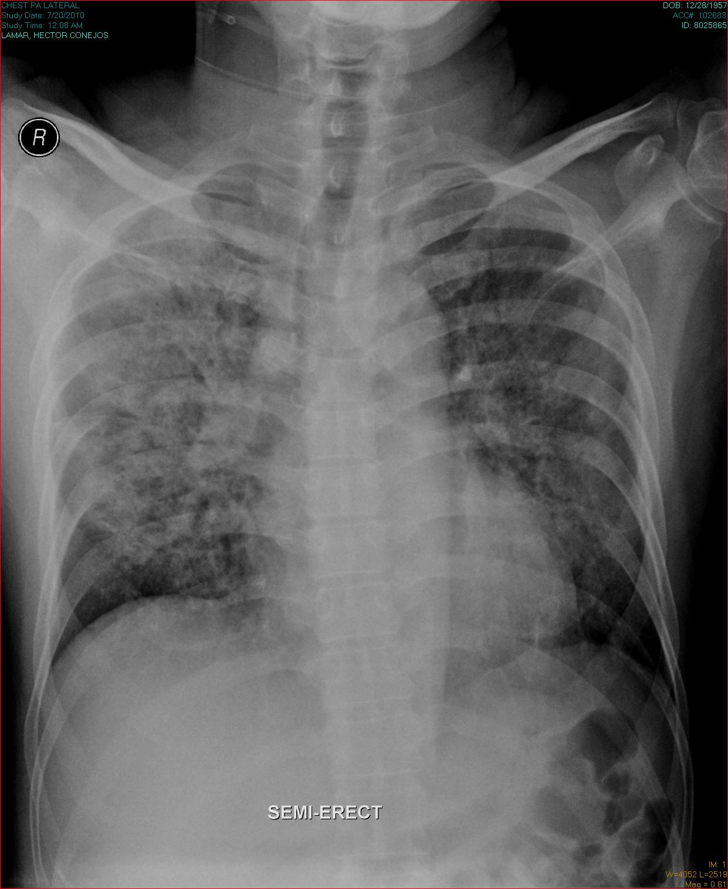

Slide 19
7th Hospital Day
Episodes of headache
CT scan of the brain: Normal
Fundoscopic findings: Normal

Slide 20
9th Hospital Day
VDRL - negative
HEPATITIS PROFILE
Anti HAV IgG-reactive
Anti-HCV- non-reactive
HbsAg- non-reactive
Anti-HBS- reactive

Slide 21
14th Hospital Day
Lumbar tap
Amphotericin B started
Protein | 52mg/dl
Glucose | 55.15mg/dl
India ink | Positive
CALAS Qualitative Quantitative | Positive 1:64 dilutions
RBC | 217/uL
WBC | 0/uL

Slide 22
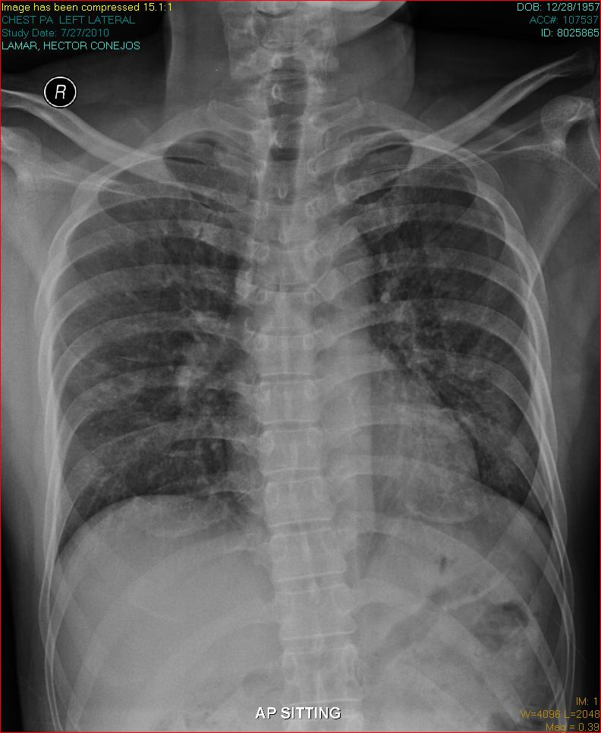
15th Hospital Day

Slide 23
16th -26th Hospital Days
Treatment with Amphotericin Continued
Electrolytes Monitored
 | 8/4 | 8/8 | 8/11 | 8/14
Na |  |  | 133 | 139
K |  | 4.2 | 3.9 | 3.9
Crea | 0.99 | 1.07 | 1.09 | 0.76
BUN |  | 8.41 | 7.4
Mg |  | 1.75 | 1.75 | 1.75

Slide 24
27th Hospital Day
Feels much better
Asymptomatic
Lumbar tap – CALAS and india ink positive
Discharged and monitored closely as outpatient
Treatment:
Fluconazole and cotrimoxazole
Antiretroviral therapy
Nevirapine
Lamivudine+Zidovudine

Slide 25
FINAL DIAGNOSIS:
Disseminated Cryptococcosis
Acquired Immunodeficiency Syndrome

Slide 26
Follow up
Patient is doing well
Asymptomatic
 | 12/4
Protein | 48.4
Glucose | 58.15
India ink | Negative
CALAS Qualitative Quantitative | Negative
RBC | 3/uL
WBC | 2/uL
AFB culture&smear

Slide 27
CRYPTOCOCCOSIS
Global invasive mycosis
Approximates 1 million cases annually worldwide
Management: a.Established antifungal regimens b. aggressive Tx of underlying disease

Slide 28
CRYPTOCOCCOSIS
Yeast-like fungus Cryptococcus neoformans
spectrum consists of
Meningoencephalitis
Pneumonia
Skin and soft tissue infection
Hematologic malignancies, organ transplants, glucocorticoid therapy, HIV infection

Slide 29
PATHOGENESIS

Slide 30
VIRULENCE FACTORS
Notes:
1. It acts as an antiphagocytosis barrier.
2. It depletes complement.
3. It produces antibody unresponsiveness.
4. It dysregulates cytokine secretion.
5. It interferes with antigen presentation.
6. It produces brain edema.
7. It creates selectin and tumor necrosis factor receptor loss.
8. It allows a highly negative charge around yeast cells.
9. It extrudes itself into the intracellular environment with the potential for local toxicity on cellular organelles.
10. It enhances HIV replication.
1. Cell wall support or integrity
2. Alteration in cell wall charge
3. Interference with T-cell response
4. Abrogation of antibody-mediated phagocytosis
5. Protection from temperature changes and antifungal agents

Slide 31
DIAGNOSIS

Slide 35
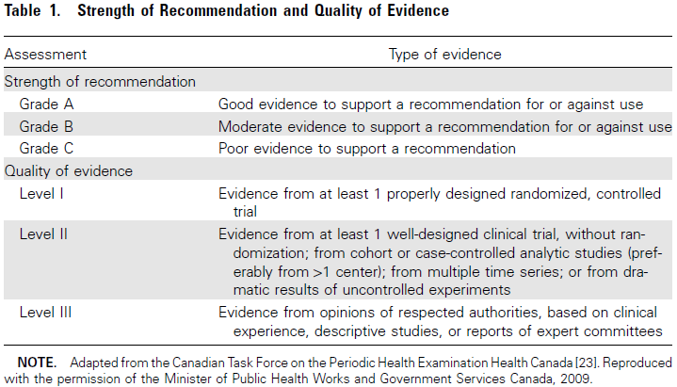

Slide 36
For Patients With Non-meningeal Cryptococcosis
Pulmonary
In immunosuppressed patients with pulmonary cryptococcosis, meningitis should always be ruled out by lumbar puncture (B-II)
Pneumonia associated with CNS or documented dissemination and/or severe pneumonia is treated like CNS disease (B-III)

Slide 38
Primary therapy: induction and consolidation
Amphotericin B (AmB) deoxycholate (0.7-1mg/kg/day IV) plus Flucytosine (100mg/kg/day orally divided into 4 doses) for at least 2 weeks followed by fluconazole (400mg [6mg/kg] per day orally) for a minimum of 8 weeks (A-I).
*Lipid formulations of AmB can be substituted among patients with or predisposed to renal dysfunction (B-II)

Slide 39
Primary therapy: Alternative Regimens for Induction and Consolidation
2. AmBd (0.7-1mg/kg/day IV), liposomal AmB (3-4 mg/kg/day IV) or ABLC (5mg/kg/day) for 4-6weeks (A-II)
*liposomal AmB has been given safely a 6mg/kg/day in cryptococcal meningoenchephalitis and could be considered in the event of treatment failure of high-fungal burden disease

Slide 40
Primary therapy: Alternative Regimens for Induction and Consolidation
3. AmB (0.7mg/kg day IV) plus fluconazole (800mg/day orally) for 2 weeks followed by fluconazole 800mg/day for a minimum of 8 weeks (B-I).
4. Fluconazole (≥800md/day; 1200 mg per day is favored) plus flucytosine (100mg/kg per day orally) for 6 weeks (B-II).

Slide 41
Primary therapy: Alternative Regimens for Induction and Consolidation
5. Fluconazole (800-2000mg/day orally) for 10-12 weeks; a dosage of ≥1200mg/day is encouraged if fluconazole alone is used (B-II).

Slide 42
Maintenance (suppressive) and Prophylactic Therapy
7. Fluconazole (200mg/day orally) (A-I)
8. Itraconzaole (200mg 2x/day; drug-level monitoring) (C-I).
9. AmBd (1mg/kg per weekIV); this is less effective than azoles, associated with IV catheter related infection; use for azole- intolerant individuals (C-1).

Slide 43
Maintenance (suppressive) and Prophylactic Therapy
10. Initiate HAART 2-10 weeks after commencement of initial anti-fungal treatment (B-III).
11. Consider discontinuing suppressive therapy during HAART in patients with a CD4 cell count >100 cells/uL and an undetectable or very low HIV RNA level sustained for ≥3 months (minimum of 12 months antifungal therapy); Consider reinstitution of maintenance therapy if CD4 cell count decreases to < 100 cells/uL (B-III).

Slide 44
Maintenance (suppressive) and Prophylactic Therapy
12. Asymptomatic antigenemia - perform lumbar puncture and blood culture
*if positive, treat as symptomatic meningoencephalitis. *Without evidence, treat with fluconazole (400mg/day oral) until immune reconstitution.

Slide 45
Maintenance (suppressive) and Prophylactic Therapy
13. Primary antifungal prophylaxis for cryptococcosis is not routinely recommended in HIV-infected patients in the US and Europe, but with areas with limited HAART availability, high levels of antiretroviral drug resistance and high burden of disease might consider it or presumptive strategy with serum cryptococcal antigen testing for asymptomatic antigenemia (B-I).

Slide 46
Management of Complications in Patients with Cryptococcosis
PERSISTENCE
Persistent positive results of cultures of CSF after 4 weeks of proven antifungal therapy.
RELAPSE
Recovery of viable cryptococci from a previously checked sterile body site
Recrudescence of signs and symptoms at the previous site of disease

Slide 47
Management of Complications in Patients with cryptococcosis
PERSISTENCE
Improve immune status (eg. Decrease immunosuppressant, introduce HAART) B-III
Reinstitute induction therapy for longer course (4-10 weeks) B-III
Consider increasing the dose of the initial dosage of induction therapy B-III
If polyene intolerant, consider fuconazole plus flucytosine B-III

Slide 48
Management of Complications in Patients with cryptococcosis
PERSISTENCE
If flucytosine intolerant, consider AmBd plus fluconazole B-III
Ideally, persistent and relapse isolates should be checked for changes in the minimum inhibitory concentration: a ≥3 dilution difference suggests development of drug resistance. B-III
Adjunctive immunological therapy - recombinant interferon γ for 10 weeks B-III

Slide 49
Management of Complications in Patients with cryptococcosis
RELAPSE
Restart induction phase therapy B-III
Determine susceptibility of the relapse isolate B-III
After induction therapy and in-vitro susceptibility testing; consider salvage therapy with either fluconazole, voriconazole or posaconzaole for 10-12 weeks B-III

Slide 50
Management of Complications in Patients with cryptococcosis
IRIS (Immune Reconstitution inflammatory Syndrome)
Various microorganisms
Major complication of AIDS → HAART
Unmasking- start of HAART
Paradoxical- during treatment of cryptococcosis and administration HAART
Can present in body sites that were initially identified as infected

Slide 51
Management of Complications in Patients with cryptococcosis
IRIS
Clinical manifestation compatible with
Exuberant tissue inflammation in patients experiencing rapid improvement in cellular immunity
Fever with peripheral or mediatsinal lymphadenitis
CNS signs and/or symptoms of disease
Results of culture are negative

Slide 52
Management of Complications in Patients with cryptococcosis
IRIS
No need to alter direct anti-fungal therapy B-III
No definitive specific treatment recommendation for minor IRIS manifestation is necessary→ resolve spontaneously in days to week B-III
CNS inflammation with ICP, may consider corticosteroids possibly dexamethasone B-III

Slide 53
Elevated CSF Pressure
Identify CSF pressure at baseline
CSF pressure < 25 cm of CSF + increased ICP symptoms
relieve by CSF drainage
persistent pressure elevation >25 cm of CSF
repeat lumbar puncture daily until the CSF
pressure and symptoms have been stabilized
for >2 days
consider temporary percutaneous lumbar drains or ventriculostomy

Slide 55
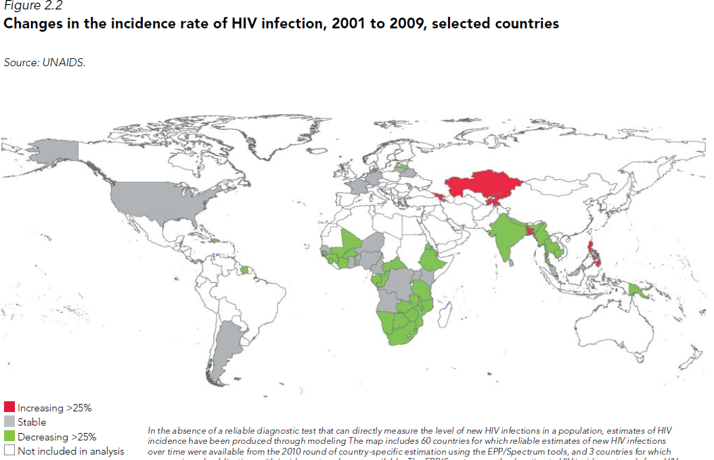

Slide 56
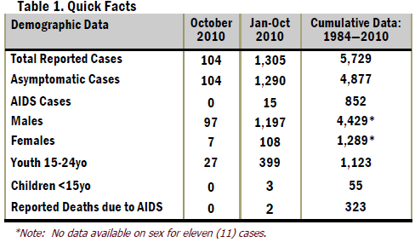

Slide 57
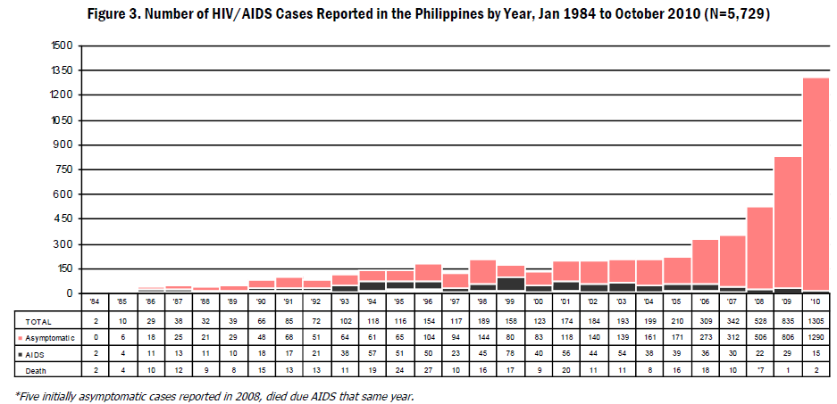

Slide 58
HIV and Cryptococcosis
Annual incidence of cryptococcosis 2-7 cases per 1000 HIV-infected patients
89% CNS infection
4th most common oppurtunistic infection in HIV patients
Acute mortality rate 6-14%
Relapse after treatment is high (30-50%)
HIV-1 Associated Oppurtunistic Infections- CNS Cryptococcosis
Niranjan et al. Feb 2010

Slide 59
CONCLUSION
Cryptococcocis is a fatal disease and is a common oppurtunistic infection
Prompt recognition and inititiation of therapy is warranted
Increased incidence of HIV/AIDS in the Philippines...be vigilant.

Slide 60
Thank you!

Slide 61
Course
6
13
26
20
HOSPITAL DAY

Slide 62
Acute, subacute, chronic meningitis
Cryptococcomas of brain (abscesses)
Spinal cord granuloma
Chronic dementia (from hydrocephalus)
CENTRAL NERVOUS SYSTEM

Slide 64
Papilledema
Extraocular muscle paresis
Keratitis
Chorioretinitis
Endophthalmitis
Optic nerve atrophy
EYE

Slide 65
Thyroiditis
Thyroid mass
THYROID

Slide 66
Nodules (single or multiple)
Lobar infiltrates
Interstitial infiltrates
Cavities
Endobronchial masses
Endobronchial colonization
Acute respiratory distress syndrome
Mediastinal adenopathy
Hilar adenopathy
Pneumothorax
Pleural effusions/empyema
Miliary pattern
LUNGS

Slide 68
Papules and maculopapules
Subcutaneous abscess
Plaques
Cellulitis
Purpura
Acne
Draining sinuses
Ulcers
Bullae
Herpetiformis-like
Molluscum contagiosum-like
INTEGUMENTARY SYSTEM

Slide 71
Cryptococcemia
Endocarditis (native and prosthetic)
Mycotic aneurysm
Myocarditis
Pericarditis
Infected vascular graft
CARDIOVASCULAR SYSTEM

Slide 72
Esophageal nodule
Nodular or ulcerated lesions in stomach or intestines (may resemble Crohn's)
Hepatitis
Peritonitis
Pancreatic mass
GASTROINTESTINAL SYSTEM

Slide 73
Prostatitis
Renal cortical abscess
Positive urine culture from occult source
Genital lesions
GENITOURINARY SYSTEM

Slide 75
Cryptococcosis in a resource-limited health care environment
Where flucytosine is not avaialable
Induction therapy: AmBd 1mg/kg/day for 2 weeks or AmBd plus fluconazole for 8 weeks (A-I)
Maintenace therapy: Fluconazole (200-400 mg per day until immune reconstitution (A-I)

Slide 76
Cryptococcosis in a resource-limited health care environment
When polyene is not available
Induction therapy: Fluconazole (≥800mg/day; 1200mg is favoured) for at least 10 weeks or until CSF culture is negative
Maintenance therapy: fluconazole (200-400mg/day) B-II

Slide 77
Cryptococcosis in a resource-limited health care environment
When polyene is not available but flucytosine available
Induction therapy: Fluconazole (≥800mg/day; 1200mg is favoured) plus flucytisine (100mg/kg/day orally) for 2-10 weeks
Maintenance therapy: fluconazole (200-400mg/day) B-II

Slide 78
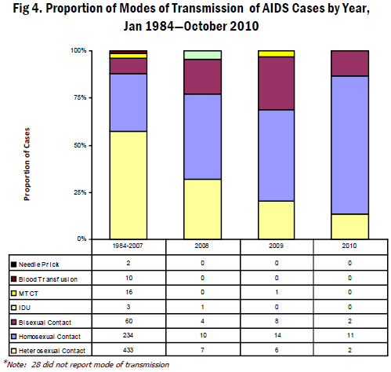

Slide 82
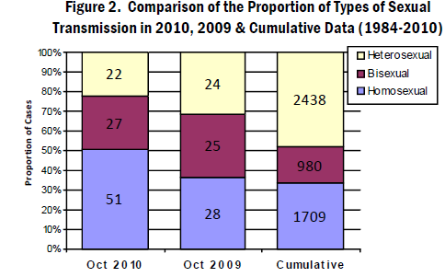

Slide 83
